Slide 1
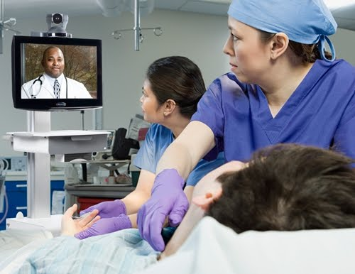
Telemedicine
Melissa M. Starry
Compliance Bootcamp
(5/15)

Slide 2
This presentation is similar to any other legal education materials designed to provide general information on pertinent legal topics. The statements made as part of the presentation are provided for educational purposes only. They do not constitute legal advice nor do they necessarily reflect the views of Holland & Hart LLP or any of its attorneys other than the speaker. This presentation is not intended to create an attorney-client relationship between you and Holland & Hart LLP. If you have specific questions as to the application of law to your activities, you should seek the advice of your legal counsel.

Slide 3
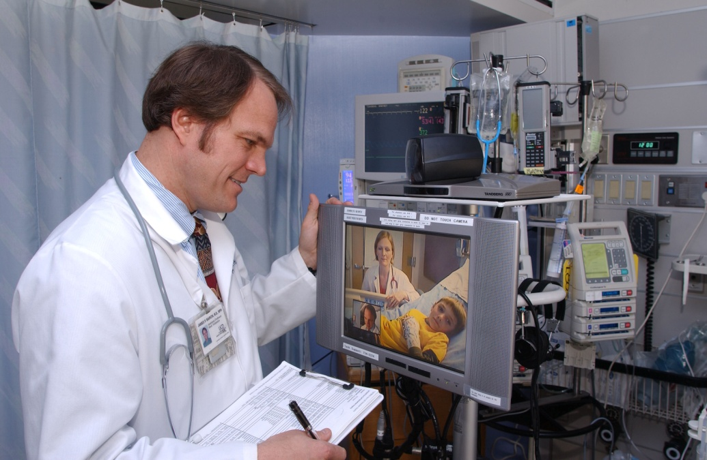
Telemedicine
“Telemedicine” = provision of clinical services to patients by physicians and practitioners from a distance via electronic communications.
Simultaneous or “real time” (e.g., teleICU)
Non-simultaneous, “store-and-forward” (e.g., teleradiology)

Slide 4
Telemedicine Legal Issues
Licensure
General requirements
Idaho requirements
Credentialing
General rules
New COPs regarding credentialing telemedicine providers

Slide 5
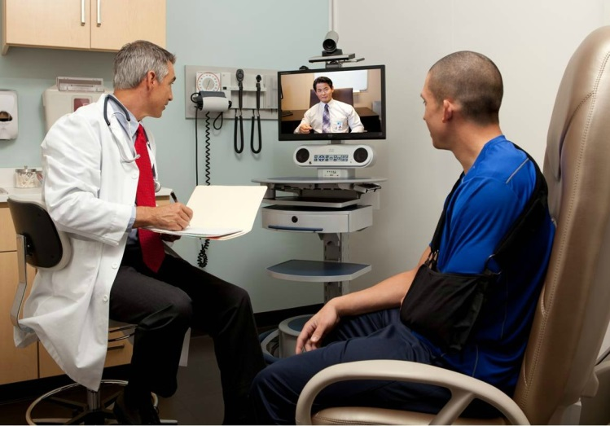
Telemedicine - Generally
Originating Site:
Where the patient is located
Distant Site:
Where the remote practitioner is located
Telemedicine

Slide 6
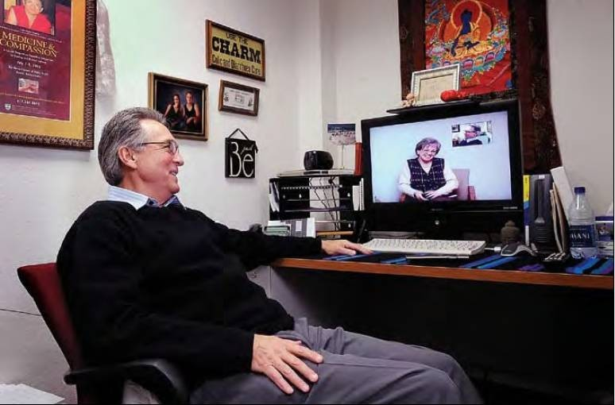
Idaho Telehealth Access Act

Slide 7
Idaho Telehealth Access Act
Signed by Governor Otter this legislative session.
To be codified at Idaho Code 54-5601 et seq.
Legislative findings:
Telehealth services enhance access to health care, make delivery of health care cost efficient, and distribute limited health care provider resources more efficiently.
Telehealth services improve health outcomes, decrease costs, address an unmet need for health care by persons who have limited access to care due to geographic barriers.

Slide 8
Idaho Telehealth Access Act
What does the Act do?
Provides a mechanism for the establishment of a provider-patient relationship via two way audio and visual interaction (instead of requiring an in-person interaction in order to establish the relationship).
HOWEVER provider must still satisfy the community standard of care as if the provider and patient were having an in-person interaction. And if you violate the community standard of care, the Board is going to come after you.
Regulations from the Board of Medicine and Board of Nursing are forthcoming…
Board of Medicine guidelines for telemedicine are on their website…

Slide 9
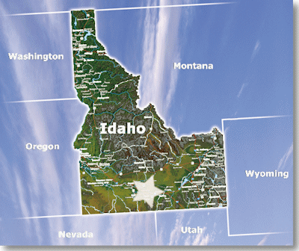
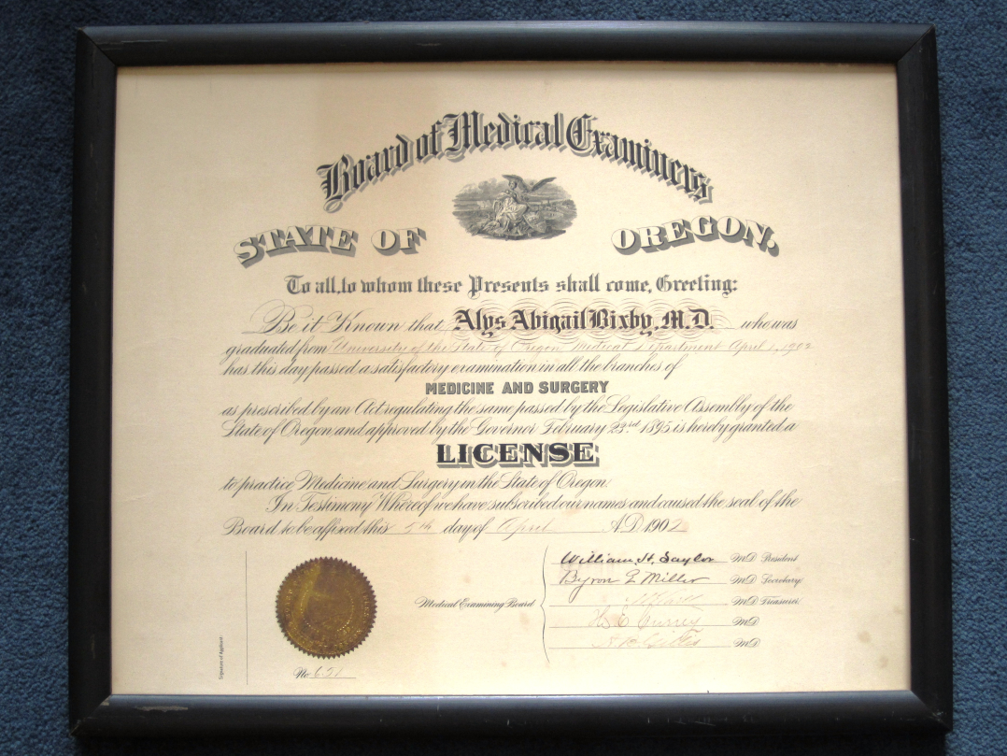
Licensure

Slide 10
Licensure
Who cares?
Telemedicine provider
Subject to criminal or administrative sanctions if not properly licensed, i.e., practicing without license
No liability insurance
No reimbursement for services provided
Originating site
No liability insurance for provider
No reimbursement for services provided
Facility licensing problems
COP problems
Maybe subject to negligent credentialing liability if bad outcome

Slide 11
Licensure
State laws generally require that practitioners be licensed by the state in which the patient is located.
States prohibit unauthorized practice of medicine.
“Practice medicine” = usually interpreted as place where patient is located.
State in which patient is located will usually apply its own law.
States may vary how they address telemedicine.
Full license or limited license required.

Slide 12
Idaho Licensure
“Practice medicine” =
To investigate, diagnose, treat or prescribe for any disease, ailment, injury, or other condition by any means.
To apply principles or techniques of medical science in the prevention of any such conditions.
To offer, undertake, attempt or hold oneself out as able to do any of the foregoing.
(IC 54-1803(1))
Unauthorized practice of medicine = felony
Up to $10,000 fine
5 years in prison
Adverse action against license

Slide 13
Idaho Licensure
“Consultation” exception:
A person residing and licensed in another state or country may practice medicine in Idaho if:
He is consults with a physician licensed in Idaho, and
He or she does not open an office or appoint a place to meet patients or receive calls in Idaho.
(IC 54-1804(b))
Test: direct care v. consultation
Frequency?
Other physician involved?
If telemedicine provider contracts to provide services for hospital, practitioner must be licensed in Idaho.

Slide 14
Idaho Licensure
Board of Medicine Interpretation regarding Reading of Radiologic or Imaging Studies (3/5/04)
“It is the interpretation of the Idaho State Board of Medicine that a physician reading radiologic or imaging studies done in Idaho on Idaho patients by an Idaho physician must hold an Idaho license to practice medicine unless the radiologic or imaging studies are sent to an out-of-state physician directly by an Idaho licensed physician to obtain consultation on a patient.”
(Available on Board of Medicine website)

Slide 15
Idaho Licensure
Board of Medicine Interpretation regarding Reading of Pathology Studies (Undated)
“It is the interpretation of the Idaho State Board of Medicine that a physician performing pathology tests on samples taken in the State of Idaho on Idaho patients by an Idaho physician must have an Idaho license to practice medicine if the physician performing pathology tests is rendering a diagnosis for inclusion in the patient’s medical chart unless the pathology tests are sent to an out-of-state physician directly by an Idaho licensed physician to obtain consultation on a patient.”
(Available on Board of Medicine website)

Slide 16
Idaho Licensure
For Idaho Medicaid reimbursement, the telemedicine physician providing care must have a current Idaho licensure. (Medicaid Info Release MA08-01)

Slide 17
Hospital COPs
In all cases, healthcare professional must be legally authorized to practice in the state where the hospital is located. (Interpretive Guidelines for 42 CFR 482.12 and .22)
When telemedicine is used and the practitioner and patient are located in different states, the practitioner providing the patient care service must be licensed and/or meet the other applicable standards that are required by the state or local laws in both the state where the practitioner is located and the state where the patient is located.
(Interpretive Guidelines for 42 CFR 482.11(c))

Slide 18
Restrictions on Remote Prescribing
Early internet pharmacies were prescribing based solely on online questionnaires or similar methods.
In response, many states or medical boards require an in-person physical exam before allowing the practitioner to prescribe or render treatment.
Medical practices act
Statement of medical boards
See http://www.fsmb.org/pdf/InternetPrescribing-law&policylanguage.pdf.
Check relevant laws concerning in-person contact.

Slide 19
Idaho Law Regarding Remote Prescribing
“A prescription drug order for a legend drug is not valid unless it is issued for a legitimate medical purpose arising from a prescriber-patient relationship which includes a documented patient evaluation adequate to establish diagnoses and identify underlying conditions and/or contraindications to the treatment. Treatment, including issuing a prescription drug order, based solely on an online questionnaire or consultation outside of an ongoing clinical relationship does not constitute a legitimate medical purpose.”
Subject to several exceptions.
Idaho Telehealth Access Act: allows the provider-patient relationship to be established via telehealth.

Slide 20
Licensure
To summarize:
Telemedicine provider in another state → Idaho
Ensure outside practitioner has an Idaho license, or
Make sure—
Outside practitioner consults with Idaho practitioner, and
Outside practitioner does not open shop in Idaho or contract with hospital to provide services in Idaho.
Medicaid may not pay for unlicensed provider.
Telemedicine provider in Idaho → another state
Check laws of the other state

Slide 21
Interstate Medical Licensure Act
Also signed by Governor Otter this session.
The Interstate Medical Licensure Compact was developed by representatives of state medical boards from across the country. It does not quite exist yet – 6 states have passed legislation like this. They are waiting on one or two more, but we are likely at least a year out on this.
Idea is to enhance the portability of the medical license and streamline the process for applying for medical licenses in multiple states by expediting the licensing process for physicians already licensed in compact states who meet the Idaho requirements.
Physician must designate one of the member states as the state of principal license for the purpose of registration.
The Board of Medicine will participate in the rules and governance of the commission that manages the Compact. The Compact will share data on practitioners who choose to use the expedited licensing process, share disciplinary information, and participate in joint investigations. Disciplinary actions will remain the duty/option of the Board of Medicine.

Slide 22
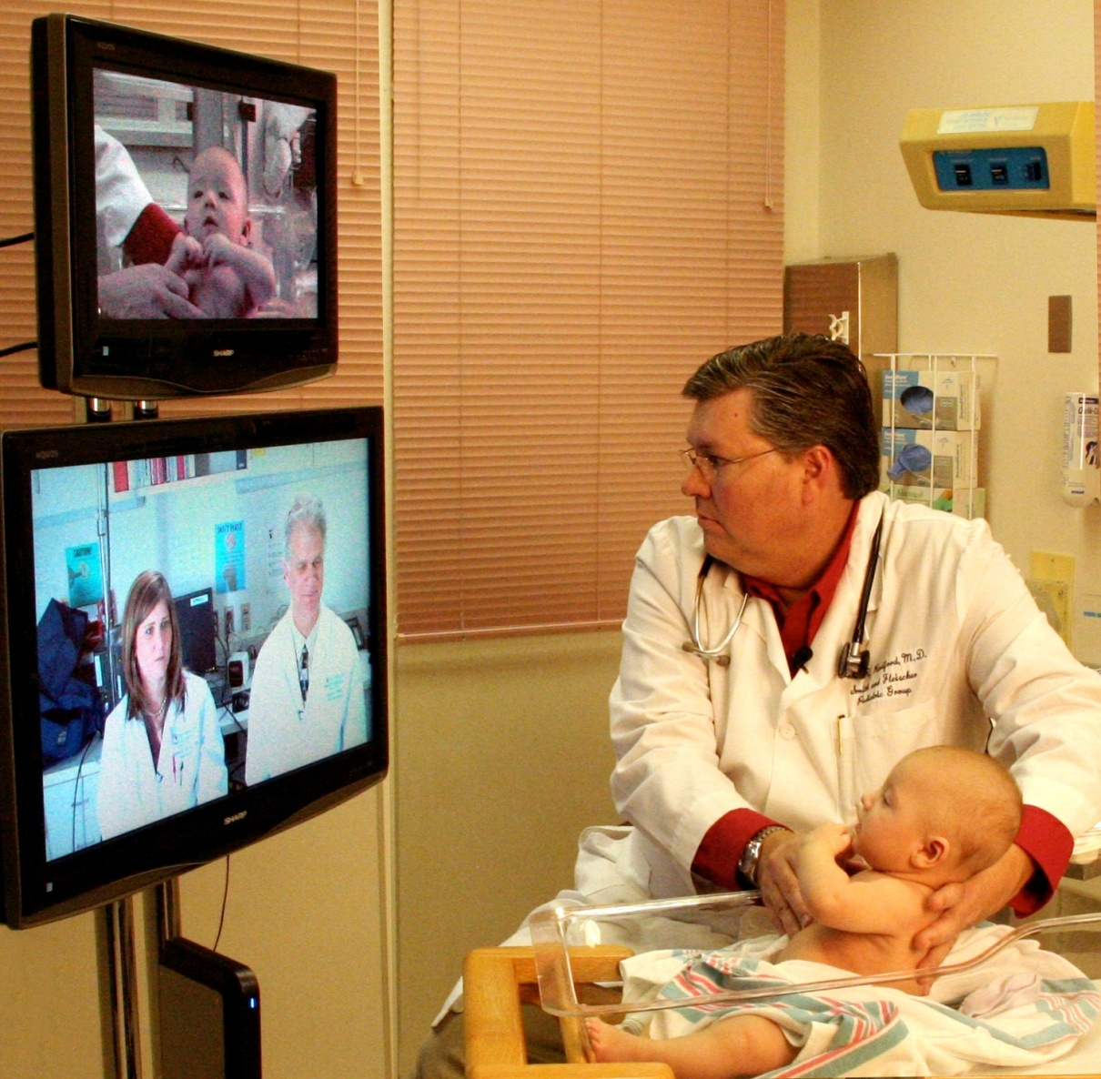
Credentialing

Slide 23
Credentialing and Privileging
States usually require credentialing of practitioners to provide services at hospitals or other facilities.
State statutes or licensing regulations.
Common law tort duty.
Medical staff bylaws require credentialing.
Statutes, regs, or bylaws may require individual credentialing.
Individual credentialing for telemedicine is problematic.
Facility may have many providers rendering telemedicine services, e.g., teleradiology.
Facility may not be qualified to assess competence of telemedicine providers through internal credentialing.

Slide 24
Idaho Hospital Rules
Idaho hospital statutes and regulations
Do not expressly cover telemedicine credentialing.
Contemplate individual credentialing.
Medical staff members must be qualified for privileges.
Privileges granted only on basis of individual training, competence and experience.
Process must include application, agreement to comply with bylaws, and delineation of privileges.
Must include board, administration and active medical staff.
Reappointment every two years.
(IDAPA 16.03.14.200 and -.250)

Slide 25
Medicare Conditions of Participation
Allows credentialing by proxy for telemedicine providers, i.e., hospital may accept credentialing done by distant site if meet certain standards.
Must have agreement between the hospital/CAH and either:
Distant-site hospital that participates in Medicare; or
Distant-site telemedicine entity, i.e.,
provides telemedicine services
not a Medicare-participating hospital
provides services in manner that allows hospital or CAH to meet all COPs.
(42 CFR 482.12 and 485.616; 76 FR 25550 (5/5/11); CMS Transmittal 78 (12/22/11)

Slide 26
Credentialing: Hospital COPs
COPs only allow credentialing by proxy for telemedicine privileges.
If practitioner provides non-telemedicine services, hospital must credential practitioner in traditional manner.
For telemedicine services, hospital/CAH’s governing board has the option to:
allow medical staff to rely on credentialing done by distant hospital or entity under new COPs, or
require med staff to credential each telemedicine provider.

Slide 27
Credentialing: Emergency privileges
Many state laws, regulations and/or bylaws allow facilities to grant temporary or emergency privileges.
Granted in limited circumstances, e.g.,
While normal credentialing process occurs.
Unique patient care need.
Subject to limited, preliminary review.
Privileges limited to no more than 60 days.
Unclear how this would coordinate with telemedicine COPs.

Slide 28
Credentialing: Medical Staff Bylaws
May need to update your medical staff bylaws to address telemedicine.
Qualifications for medical staff members.
e.g., geographic proximity, admissions, etc.
Categories of medical staff members.
e.g., add telemedicine staff category
Privileges.
e.g., grant telemedicine privileges without med staff
Credentialing process.
e.g., allow credentialing by proxy based on new COPs.
CMS survey process requires review of medical staff bylaws to verify compliance.

Slide 29
Questions?
Melissa M. Starry
mmstarry@hollandhart.com
Kim C. Stanger
kcstanger@hollandhart.com

