Slide 1
Interpreters, Translators, and Auxiliary Aids: Provider Obligations
Melissa M. Starry

Slide 2
Important information
This presentation is similar to any other seminar designed to provide general information on pertinent legal topics. The statements made and any materials distributed as part of this presentation are provided for educational purposes only. They do not constitute legal advice nor do they necessarily reflect the views of Holland & Hart LLP or any of its attorneys other than the speakers. This presentation is not intended to create an attorney-client relationship between you and Holland & Hart LLP. If you have specific questions as to the application of the law to your activities, you should seek the advice of your legal counsel.
All Presentations and Other Materials © Holland & Hart LLP 2015

Slide 3
Preliminaries
This is an overview of relevant laws concerning communication with patients or companions.
Additional laws apply to other issues. (we’re not going to cover these)
Eligibility for or participation in programs.
Physical access and retrofits.
Discrimination for reasons other than ability to communicate (e.g., HIV).

Slide 4
Preliminaries
Application of the laws depend on facts of the situation.
Type of provider.
Needs of patient.
Nature and complexity of communication involved.
Provider’s resources.
Reasonableness of provider’s actions.
Aggressiveness of the relevant government agency.
Law is evolving.
HHS working on proposed regulations under the ACA’s anti-discrimination statute. (RegInfo.gov Dashboard says proposed rule was submitted April 29th – per email communication with OCR this week, should be published “This Spring.”)

Slide 5
Communication Barriers

Slide 6
Communication Barriers
Patient or personal representative:
Speaks foreign language.
Suffers a disability that impairs effective communication.
Hearing impaired.
Visually impaired.
Other impairment?
Lacks sufficient education to understand provider.
Lacks sufficient capacity to understand provider.

Slide 7
Why do we care?
Cannot provide proper care without effective communication.
Inability to obtain info necessary to provide effective care.
Lack of informed consent for care.
Provider liability for resulting injuries.
Malpractice
Battery
False imprisonment
Lack of informed consent
Licensing and ethical standards.
Accreditation standards.
Anti-discrimination statutes may require reasonable accommodations.

Slide 8
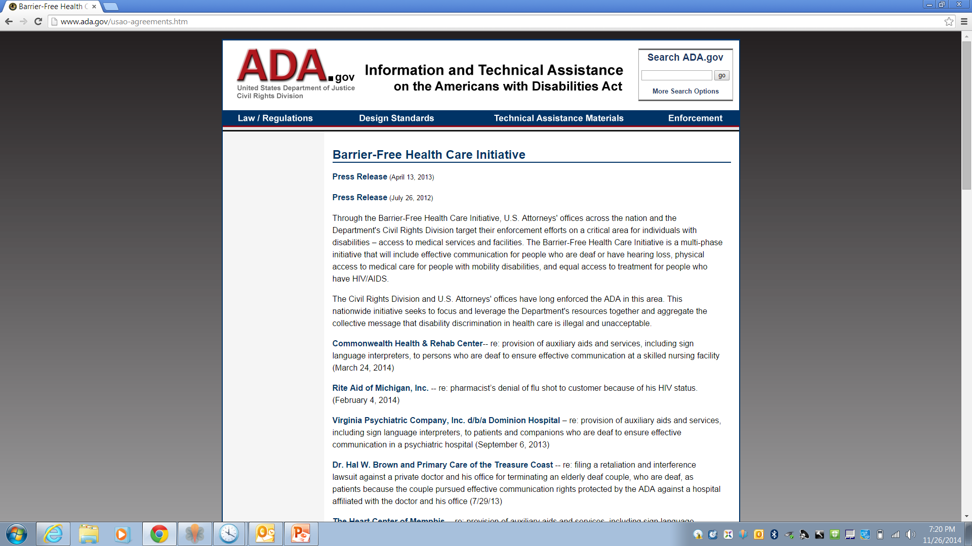

Slide 9
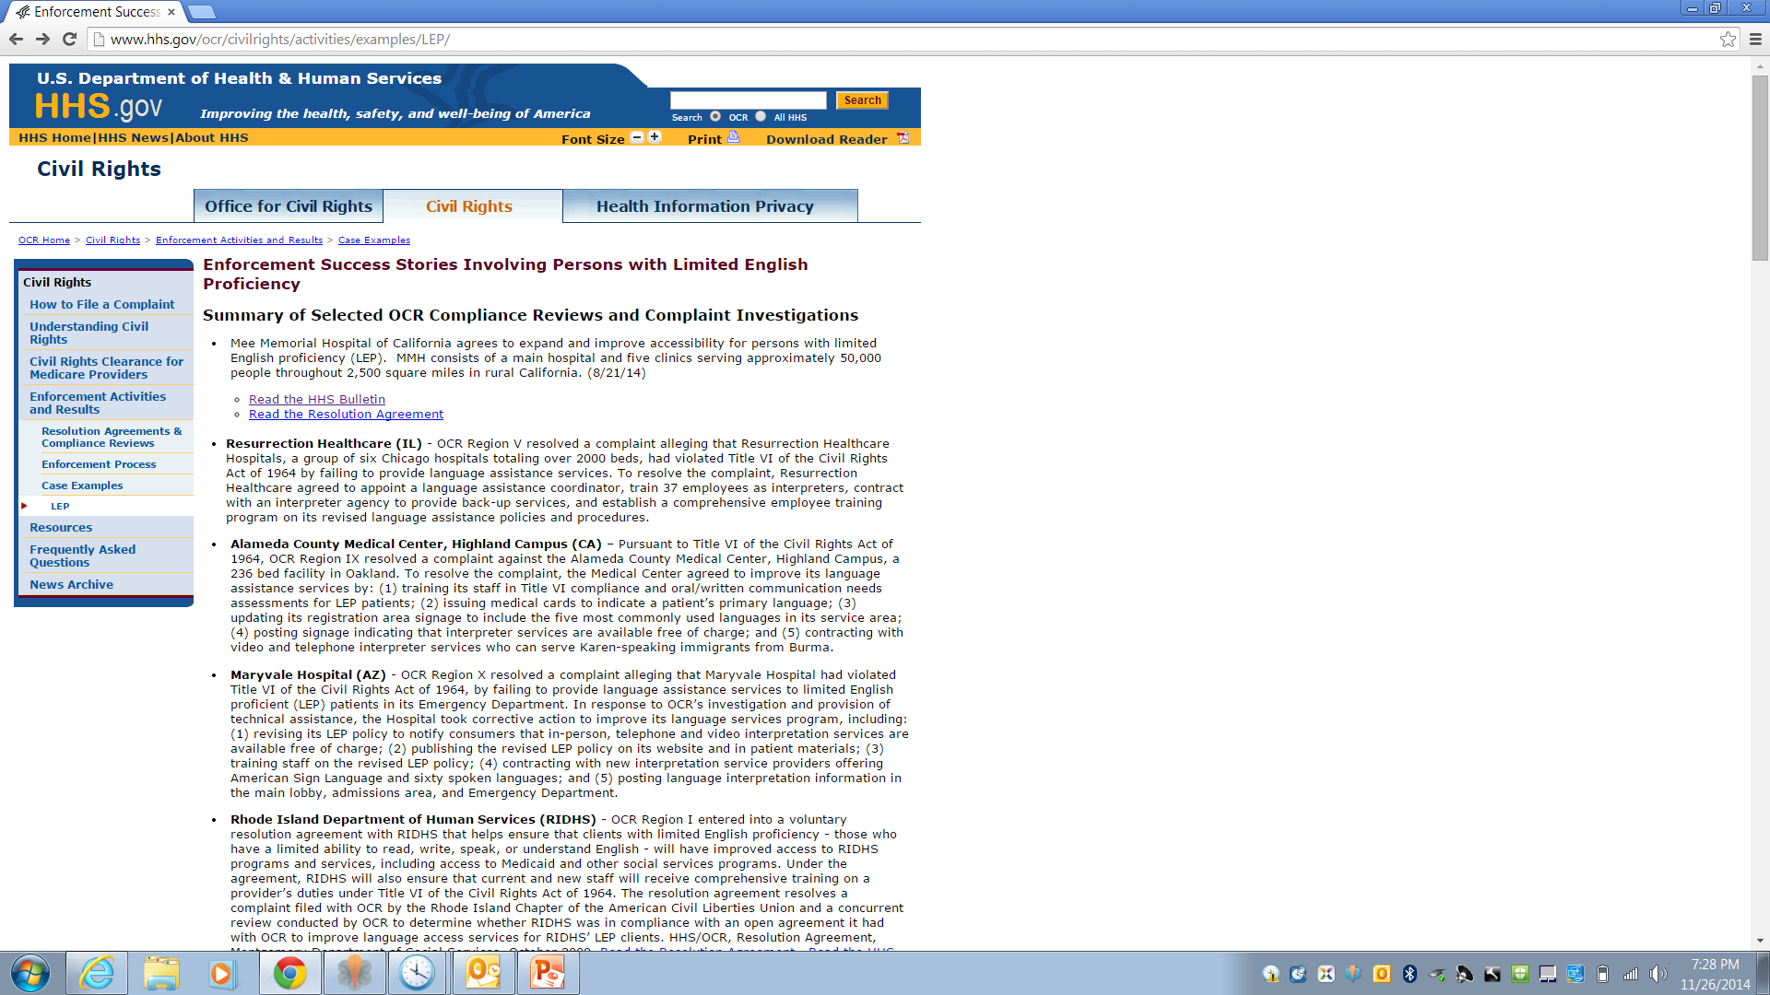

Slide 10
Why do we care?
Gerena v. Fogari (NJ 2008)
Facts
Physician declined to pay $200 per visit for interpreter requested by deaf patient, claiming that he could not afford interpreter.
Physician communicated with patient through family members.
Held: Jury found violations of anti-discrimination statutes
$200,000 damages
$200,000 punitive damages
$400,000

Slide 11
Why do we care?
Even if we aren’t worried about the government, patients or personal representatives often understand the law better than providers.
Many are very sensitive to discrimination issues.
Many are educated about the law, their rights, and your responsibilities.
Some may try to impose obligations beyond those required by applicable laws, e.g.,
Demand their own choice of interpreters or auxiliary aids even though law may not require provider to use such services or aids.
Demand provider to pay for interpreter or auxiliary aid that patient brings.
They may be willing and able to file complaints if you act improperly.

Slide 12
General Requirements
Provider must generally make reasonable accommodations (e.g., interpreter services or auxiliary aids) for:
Persons who do not speak English.
Persons with a disability that impairs effective communication.
Provider generally cannot
Require patient to supply their own interpreter or auxiliary aid.
Charge patient for cost of the interpreter or auxiliary aid.
Refuse to provide care even though cost of interpreter or auxiliary aid may exceed cost of care.
* Caution: I would rather defend a discrimination claim than a malpractice claim if you really cannot provide effective care because of the communication problem.

Slide 13
Foreign Language Issues (Limited English Proficiency)

Slide 14
Applicable Laws
Affordable Care Act, Section 1557
Prohibits discrimination on the basis of race, color, national origin, sex, age and disability under any health care program receiving federal financial assistance.
(42 USC 18116)
On July 31, 2013, HHS issued a Request for Information to help draft ACA regulations, including:
Access to health programs for individuals with limited English proficiency (“LEP”), including standards for translation and interpretation services, effectiveness of services, and costs.
Requirements for self-evaluations and assessments.
Accessibility of information technology.
Suggestions for strengthening enforcement.
In meantime, OCR is responding to ACA complaints.
Reginfo.gov Dashboard says a Proposed Rule was received on April 29, 2015 (not yet published)

Slide 15
Applicable Laws
Civil Rights Act of 1967, Title VI
Prohibits discrimination in federal programs on the basis of race, color, or national origin.
Medicare part A, Medicaid, grants, loans, or contracts
NOT Medicare part B
(42 USC 2000d; 45 CFR part 80)
Bottom line: if you are a recipient of federal funds, don’t discriminate.

Slide 16
Applicable Laws
Idaho Human Rights Act
Places of public accommodation cannot deny an individual the full and equal enjoyment of the goods, services, facilities, privileges, and advantages and accommodations because of, or on a basis of, race, color, religion, sex or national origin.
(IC 67-5909 et seq.)

Slide 17
What happens if you don’t comply?
OCR investigations
Primarily complaint driven.
May perform compliance reviews.
IHRC Complaints
Consequences and penalties
Loss of federal financial assistance.
Department of Justice (DOJ) actions.
Settlement agreements
Injunctions
Penalties
Private actions
Discrimination
Malpractice
Other

Slide 18
What must you do to comply with Title VI?
Executive Order 13166 (8/00) and HHS Guidance (8/03) require recipients of federal financial assistance to take “reasonable steps” to ensure meaningful access to persons with limited English proficiency (“LEP”).
Interpreters
Translations of key documents.
8/03 HHS Guidance (“The Bible”): depends on 4 factors
1. Number or proportion of LEPs likely to be encountered by provider.
2. Frequency of contact with LEPs.
3. Nature and importance of services to LEPs.
4. Cost and resources available to provider.

Slide 19
1. Number or proportion of LEPs in service area
The more persons who speak the language, the more likely the encounter and the greater the need for LEP services.
Consider:
Prior experience and service to LEPs.
Census data.
School system data.
Local government data.
How may people do we have in our service area that speak a particular language?

Slide 20
2. Frequency of contact with LEP individuals
The more frequent the contact, the more need for LEP services.
Recipient who sees LEPs daily must do more than those who see LEPs only occasionally, e.g.,
If see daily, may need LEP alternative on site.
If see occasionally, may use commercially available telephonic interpretation service.
If see rarely, may not need LEP services.
Even if we have a lot of people in the are that speak a specific language, how often do we come into contact with them?

Slide 21
3. Nature and importance of recipient’s service
The more important the service, the greater the need for LEP services.
Would denial or delay in providing the services endanger LEPs?
If treatment critical and urgent, may need to have immediate LEP services.
If treatment is important but non-urgent, may not need immediate LEP services.
If treatment is not important, may not need same degree of LEP services.

Slide 22
4. Resources available to recipient and costs
The greater the provider’s resources, the more LEP services are expected.
The greater the cost of LEP services, the less “reasonable” they may be.
Reasonable steps may cease to be “reasonable” where the costs imposed substantially exceed the benefits.
Query: how far can we take this?
Hint: Remember to document costs and reasonableness of conduct.

Slide 23
Net result: requirements depend on circumstances
Number of LEPs in area
Frequency of contacts with LEPs
Nature and importance of services
Available resources and costs
Mix of services available
Interpreters
On-site
Skilled
Translation
Vital documents
Oral translation of documents

Slide 24
Interpreters: Some Options
Allow LEP to provide their own interpreter, e.g., family member, BUT:
Advise LEP they may receive LEP services for free.
Never require LEP to provide interpreter. IT’S YOUR OBLIGATION. THE COST OF DOING BUSINESS.
Consider documenting LEP’s choice.
Consider using interpreter service to supplement patient’s interpreter, especially if you have concerns about LEP’s interpreter.
Competency, e.g., interpreter is a minor
Confidentiality, e.g., patient may not disclose info to interpreter
Cultural factors
Suspect abuse

Slide 25
Interpreters: Some Options
Hire or train bilingual staff.
Use interpreter or translator services.
Use telephonic or video remote interpreter (“VRI”) services.
Share LEP services with other providers, e.g., purchase bulk telephonic interpretation services.
Use qualified community volunteers.
Use “I speak” (language identification) flashcard.
Create arrangement to refer LEPs to another provider so long as there is no discriminatory intent (but be careful).

Slide 26
Translations: Vital Documents
“Vital” documents = translation vital to services and important consequences if translation is not accurate and timely.
Consent forms.
Complaint forms.
Intake forms with health consequences.
Notices of patient rights, e.g., HIPAA, COPs, etc.
Notices of eligibility criteria.
Notice of free LEP services and how to obtain services.

Slide 27
Translations: Non-Vital Documents
“Non-vital” documents = translation not vital to services.
General information
Patient satisfaction survey
Menus
Large documents, e.g., enrollment handbook

Slide 28
Translations: Some Options
Standardize and share translated documents.
Ensure the translation is appropriate to your practice.
Some translated documents may be found on government websites.
Ensure the translation is appropriate to your practice.
Consider oral interpretation of some documents.
Use qualified community volunteers.
Others?

Slide 29
Implementation Plan
OCR has developed guidance.
Plan is optional, but may help compliance if OCR ever knocks on your door.
Suggested steps:
Identify LEPs with whom you have contact.
Identify available LEP services and how staff may obtain them.
Establish procedures for handling LEP situations.
Train staff.
Provide notice of LEP services to LEPs.
Monitor and update plan.

Slide 30
1. Identify individuals who need assistance
Post notice of available language services in commonly encountered languages.
Use “I speak” (language identification) flashcard.
Available at: http://www.lep.gov/ISpeakCards2004.pdf.
Include language as part of the patient record.

Slide 31
2. Inform staff of language assistance measures
Types of language services available.
How to obtain language services.
How to respond to callers.
How to respond to written communications.
How to respond to in-person contacts.
How to ensure competency of interpreters and translation services.

Slide 32
3. Train staff
Identify staff who need to be trained.
Train staff on:
Policies and procedures for compliance.
How to implement.
How to work effectively with in-person and telephone interpreters.
Orient new employees who may contact language-impaired persons.
Document and monitor training.

Slide 33
4. Provide notice of language services
Post signs concerning services in common languages.
Include services in outreach materials, such as brochures.
Work with community organizations.
Use telephone voice mail.

Slide 34
5. Modify and update plan
Monitor changes in four factors:
Common groups in service area.
Frequency of contacts.
Importance of services.
Available resources.
Monitor changes in services.
Monitor changes in documents.
Monitor staff compliance.
Seek feedback from community.

Slide 35
OCR Compliance Review Initiative: Effective Communication in CAHs

Slide 36
Additional resources: LEP
HHS Guidance: www.hhs.gov/ocr/lep/revisedlep.html.
OCR website: www.hhs.gov/ocr/lep
LEP website: www.lep.gov.
“I speak” (language identification) cards: www.lep.gov/ISpeakCards2004.pdf
LEP notices in various languages: http://lep.gov/recip.html.
OCR Compliance Review Initiative: www.hhs.gov/ocr/civilrights/activities/agreements/compliancereview_initiative.pdf
Local OCR Regional Office
Watch for ACA regulations… “This Spring”…

Slide 37
Disability Issues

Slide 38
Applicable Laws
Affordable Care Act, Section 1557
(42 USC 18116)
Rehabilitation Act of 1973, Section 504.
Recipients of federal financial assistance with more than 15 employees cannot discriminate on the basis of disability.
(29 USC 794; 45 CFR part 84)
Americans with Disabilities Act of 1990 (ADA)
Title II: public entities cannot discriminate against those with disabilities.
Title III: places of public accommodation (including hospitals and private physician offices) cannot discriminate against those with disabilities.
(42 USC 2000d; 28 CFR parts 35 and 36)

Slide 39
Applicable Laws
Idaho Human Rights Act
Places of public accommodation cannot (1) deny an individual on the basis of disability the full and equal enjoyment of the goods, services, facilities, privileges, advantages or accommodations; or (2) fail to take such steps as may be necessary to ensure that no individual with a disability is excluded, denied services, segregated or otherwise treated differently than other individuals because of the absence of auxiliary aids and services, unless the entity can demonstrate that taking such steps would fundamentally alter the nature of the goods, services, facilities, privileges, advantages, or accommodations being offered or would result in an undue burden.
(IC 67-5909)

Slide 40
What happens if you don’t comply?
OCR / DOJ investigations
DOJ lawsuits
Injunctive relief
Damages to aggrieved persons
Civil penalty
First violation: up to $55,000
Subsequent violation: up to $110,000
Settlement agreements
Loss of federal money
Private lawsuits
Injunctive relief
Attorneys fees
(28 CFR 303.501 et seq.)

Slide 41
Providers May Not…
Providers may not discriminate against persons with a disability, i.e.,
A physical or mental impairment that substantially limits one or more major life activities, including but not limited to, caring for oneself, performing manual tasks, seeing, hearing, eating, sleeping, walking, standing, lifting, bending, speaking, breathing, learning, reading, concentrating, thinking, communicating, and working.
A history or record of such an impairment; or
Regarded as having, such an impairment.
(42 USC 12131 et seq.; 28 CFR part 36)

Slide 42
What is discrimination?
Discrimination includes but is not limited to:
failure to make reasonable modifications in policies, practices, or procedures, when such modifications are necessary to afford services to individuals with disabilities, or
failure to take such steps as may be necessary to ensure that no individual with a disability is excluded, denied services, or otherwise treated differently than other individuals because of the absence of auxiliary aids and services,
unless the entity can demonstrate that:
person poses a direct threat to health or safety of others,
action would fundamentally alter the nature of service being offered (e.g., provider does not typically provide the treatment sought), or
action would result in an undue burden.
(42 USC 12101 et seq.; 28 CFR 36.208, 36.302, 36.303)

Slide 43
Undue Burden?
Undue burden = significant difficulty or expense, considering:
Nature and cost of action;
Overall size and financial resources of entity;
Legitimate safety requirements;
Impact on entity’s operations; and
Relationship to and overall size and financial resources of any parent corporation.
(28 CFR 36.104)
Fact that cost of providing auxiliary aid or service exceeds reimbursement is not, in and of itself, “undue burden.”
Difficult to establish “undue burden”

Slide 44
Providers may not…
Providers may not:
Impose a surcharge on persons with a disability to cover the costs of auxiliary aids, policy modifications, etc.
Require individual with disability to bring their own interpreter.
Rely on adult accompanying the individual with disability to interpret or facilitate communication except:
In emergency involving imminent threat to safety and there is no interpreter available; or
Where individual with disability specifically requests that the adult interpret or facilitate communication, the accompanying adult agrees to provide such assistance, and reliance on the adult for such assistance is appropriate.
Beware using family members.
Rely on minor child to interpret except in an emergency involving imminent threat to safety and there is no interpreter available.
(28 CFR 36.301(c), 36.303(c)(2))

Slide 45
What else can’t providers do?
Providers may not coerce, intimidate, threaten, or interfere with any individual in the exercise or enjoyment of their rights, e.g.,
Coerce an individual to deny or limit rights granted by the statute.
Threaten, intimidate, or interfere with an individual with a disability who is seeking to exercise their rights.
Retaliate against a person because the person has participated in an investigation or action to enforce their rights.
(28 CFR 36.206)

Slide 46
What must providers do?
Providers must furnish appropriate auxiliary aids and services where necessary to ensure effective communication with:
Persons with disabilities.
Companions with disabilities, including family member other person with whom the provider should communicate under the circumstances.
(28 CFR 36.303(c))
No auxiliary aids required if effective communication exists without them. See Board of Education v. Rowley, 458 U.S. 176 (1982) (sign language interpreter not required when lip reading or other accommodations are sufficient).
But be careful…

Slide 47
Auxiliary Aids
“The type of auxiliary aid or service necessary to ensure effective communication will vary in accordance with the method of communication used by the individual; the nature, length, and complexity of the communication involved; and the context in which the communication is taking place.”
“A [provider] should consult with individuals with disabilities whenever possible to determine what type of auxiliary aid is needed to ensure effective communication, but the ultimate decision as to what measures to take rests with the [provider], provided that the method chosen results in effective communication. In order to be effective, auxiliary aids and services must be provided in accessible formats, in a timely manner, and in such a way as to protect the privacy and independence of the individual with a disability. (28 CFR 36.303(c)(1)(ii))
But you better be right. Effective communication is key.

Slide 48
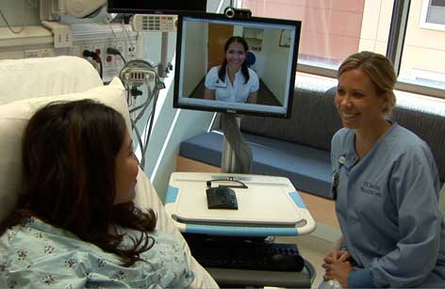
Auxiliary Aids: Hearing Impaired
Qualified interpreters on-site or through video remote interpreting (VRI) services
VRI must satisfy regulatory standards (under ADA).
(28 CFR 36.303(b)(1))

Slide 49
Auxiliary Aids: Hearing Impaired
Oral interpreters (enable patient to lip read)
Notetakers
Real-time computer-aided transcription services
Written materials
Exchange of written notes (e.g., pen and notepad or computer screen)
Telephone handset amplifiers
Assistive listening devices
Telephones compatible with hearing aids
Open and closed captioning, including real-time captioning
Voice, text, and video-based telecommunications systems, including text telephones (TTYs), videophones, captioned telephones
Other effective means of making aurally delivered info available
(28 CFR 36.303(b)(1))

Slide 50
Auxiliary Aids: Visually Impaired
Qualified readers
Taped texts
Audio recordings
Brailled materials and displays
Screen reader software
Magnification software
Optical readers
Secondary auditory programs (SAP)
Large print materials
Accessible electronic and information technology
Other effective methods of making visually delivered materials available to individuals who are blind or have low vision
(28 CFR 36.303(b)(2))

Slide 51
Auxiliary Aids: Factors to consider
Effectiveness of method of communication without and with the proposed auxiliary aid – MOST IMPORTANT
Nature and complexity of communication.
Nature of treatment or procedure.
Size of practice or facility.
Cost of alternatives.
Number of patients who will require auxiliary aids.
Patient’s preferences.
Provider’s risk tolerance.
Other?

Slide 52
Additional Considerations

Slide 53
Costs
Interpreters may cost $30 to $400/hour.
Fact that cost of interpreter exceeds reimbursement for services does not constitute “undue burden”.
Do not make the patient pay for language or auxiliary aids provided by the provider.
Provider may be able to seek reimbursement from insurer or group health plan if patient is not required to pay.
There may be federal or state funds available to cover some costs under Medicaid or SCHIP.
Small businesses may receive a tax credit for the cost of services.
Do not delay provision of services while you fight about reimbursement.

Slide 54
Timing
Provide timely services.
Undue delay may constitute discrimination or effective denial of service.
Depends on circumstances.
Where timeliness is important, cannot delay.
Where timeliness is not important, may be able to justify some delay.
May require advance notice of need for auxiliary aids so that you may arrange for auxiliary aids.

Slide 55
Paying for Patient’s Interpreter
Sometimes patient will bring interpreter who later bills physician office.
Provider is not required to pay for such services unless provider agreed to pay for service.
Make sure you have, offer, and document effective alternative.
Never require patient to provide their own interpreter.

Slide 56
Patient No-Shows?
Interpreters often require 24 hour notice of cancellation.
So can you require a patient to pay for their own interpreter if they fail to show up for their appointment where you’ve already scheduled them an interpreter?
Definitely NOT Medicaid patients.
Others? Risky, though arguable. Haven’t seen interpretation on this issue specifically.
Safer if you just charge a “no show” fee for all patients (excluding Medicaid patients – IDAPA 16.03.09.160) across the board, not at all linked to interpreter services. It won’t cover the full amount, but will defray the cost some.

Slide 57
Qualifications of Interpreters
Ensure interpreter or translator is qualified.
Check certification.
Check state laws re certification requirements.
May not know medical terms.
May not know language “regionalisms”.
May not be direct translation for some words.
May not communicate at educational level of patient.
May have conflict or be compromised by circumstances, e.g., family member. Beware using family member!
Ability to interpret does not establish ability to translate.
HIPAA still applies; get business associate contract.
Per DOJ, “qualified interpreter” is one who is able to interpret effectively, accurately, and impartially both receptively and expressively, using necessary specialized vocabulary.” (28 CFR 36.104)

Slide 58
HIPAA Concerns?
Probably do not need authorization to use interpreter.
Disclosure is for treatment, payment or healthcare operations. (45 CFR 164.506(c))
Disclosure is to persons involved in care of the patient. (45 CFR 164.510(b))
Do not need business associate agreement if:
Interpreter/translator is a member of your workforce, i.e., an employee or volunteer under your control.
Patient provides their own interpreter/translator.
Otherwise, probably need business associate agreement with interpreter/translator.

Slide 59
Tips
Review implementation plan for LEPs from OCR.
Develop policy for communication with persons with disability.
Identify patient/companion needs.
Process for assessing auxiliary aids.
Process for advising patients and family of available auxiliary aids.
Make arrangements to have auxiliary aids available, including interpreters and other relevant services.
Train staff.
Consult with patient.
Make informed decision based on applicable facts, including:
Patient’s preferences.
Effectiveness of communication.
Burden on provider.

Slide 60
Additional Help?

Slide 61
Additional Help?
HHS “committed” to providing technical assistance.
Translated forms and vital documents.
Training and info about best practices.
Identify and share model plans and examples of best practices.
Information about available resources.
Grants and model demonstration funds for LEP services.

Slide 62
Questions?
Melissa M. Starry
mmstarry@hollandhart.com
(208) 383-3984
Kim C. Stanger
kcstanger@hollandhart.com
(208) 383-3913

