Slide 1

HIPAA Privacy and Security Rules
Kim C. Stanger
Compliance Bootcamp
(5/15)

Slide 2
This presentation is similar to any other legal education materials designed to provide general information on pertinent legal topics. The statements made as part of the presentation are provided for educational purposes only. They do not constitute legal advice nor do they necessarily reflect the views of Holland & Hart LLP or any of its attorneys other than the speaker. This presentation is not intended to create an attorney-client relationship between you and Holland & Hart LLP. If you have specific questions as to the application of law to your activities, you should seek the advice of your legal counsel.

Slide 3
Health Insurance Portability and Accountability Act (“HIPAA”)
2003: Privacy Rules, 45 CFR 164.500
  Requires covered entities to protect privacy of protected health info (“PHI”)
  Gives patients certain rights concerning their info.
2005: Security Rules, 45 CFR 164.300
  Requires covered entities to implement safeguards to protect electronic PHI.
2009: HITECH Act
  Expanded and strengthened HIPAA.
2009: Breach Notification Rule, 45 CFR 164.400
  Requires covered entities to report breaches of unsecured info.
2013: HIPAA Omnibus Rule, 78 FR 5566 (1/25/13)
  Implemented and finalized HITECH Act requirements.

Slide 4
Other Privacy Laws
Must comply with other law if it is more strict than HIPAA, i.e.,
  Provides greater protection to patient info.
  Provides patients greater rights regarding their info.
Other privacy laws:
  Federally funded drug and alcohol treatment programs, 42 CFR part 2
  State drug and alcohol treatment programs
  Common law privacy rights.
  Other?

Slide 5

HIPAA Enforcement
HIPAA
Business Associates
Covered Entities

Slide 6
Criminal Penalties
Applies if employees or other individuals obtain or disclose protected health info from covered entity without authorization.
Conduct | Penalty
Knowingly obtain info in violation of the law | $50,000 fine 1 year in prison
Committed under false pretenses | 100,000 fine 5 years in prison
Intent to sell, transfer, or use for commercial gain, personal gain, or malicious harm | $250,000 fine 10 years in prison

Slide 7
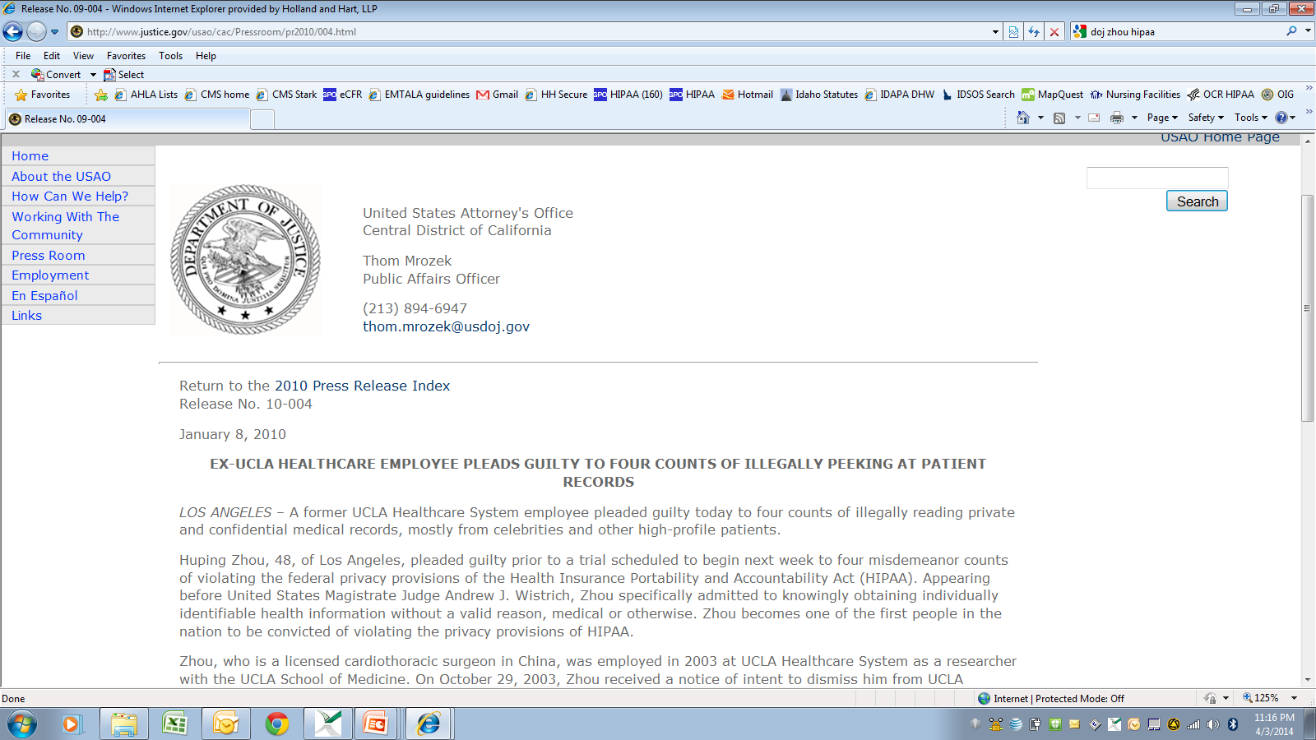

Slide 8
Civil Penalties
Conduct | Penalty
Did not know and should not have known of violation | $100 to $50,000 per violation Up to $1.5 million per type per year No penalty if correct w/in 30 days OCR may waive or reduce penalty
Violation due to reasonable cause | $1000 to $50,000 per violation Up to $1.5 million per type per year No penalty if correct w/in 30 days OCR may waive or reduce penalty
Willful neglect, but correct w/in 30 days | $10,000 to $50,000 per violation Up to $1.5 million per type per year Penalty is mandatory
Willful neglect, but do not correct w/in 30 days | At least $50,000 per violation Up to $1.5 million per type per year Penalty is mandatory

Slide 9
Civil Penalties (2014)
Anchorage Community Mental Health Services pays $150,000 for failing to maintain patches on software.
New York hospitals pay $4.8 million for leaving electronic medical records vulnerable to searches.
Concentra pays $1.7 million for lost unencrypted laptop.
QCA Health Plan pays $250,000 for lost unencrypted laptop.
Skagit County, WA pays $215,000 because PHI was available on public database.
Parkview Community Health: fined $800,000 for leaving 71 boxes of records in physician’s driveway.
All involved security rule violations

Slide 10
Enforcement
State attorney general can bring lawsuit.
  $25,000 fine per violation + fees and costs
In future, individuals may recover percentage of penalties.
  Still waiting for regulations.
Must sanction employees who violate HIPAA.
OCR to resume compliance audits.
Must self-report breaches of unsecured protected health info.
  To affected individuals.
  To HHS.
  To media if breach involves > 500 persons.

Slide 11
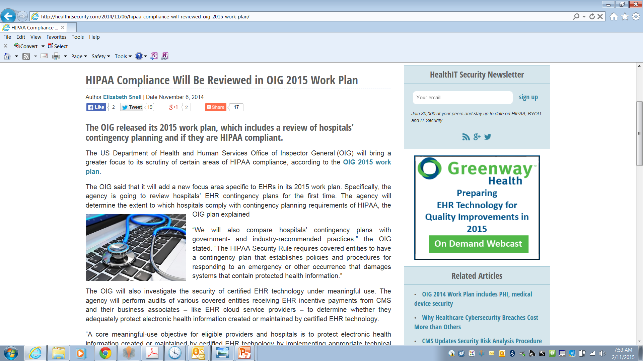

Slide 12
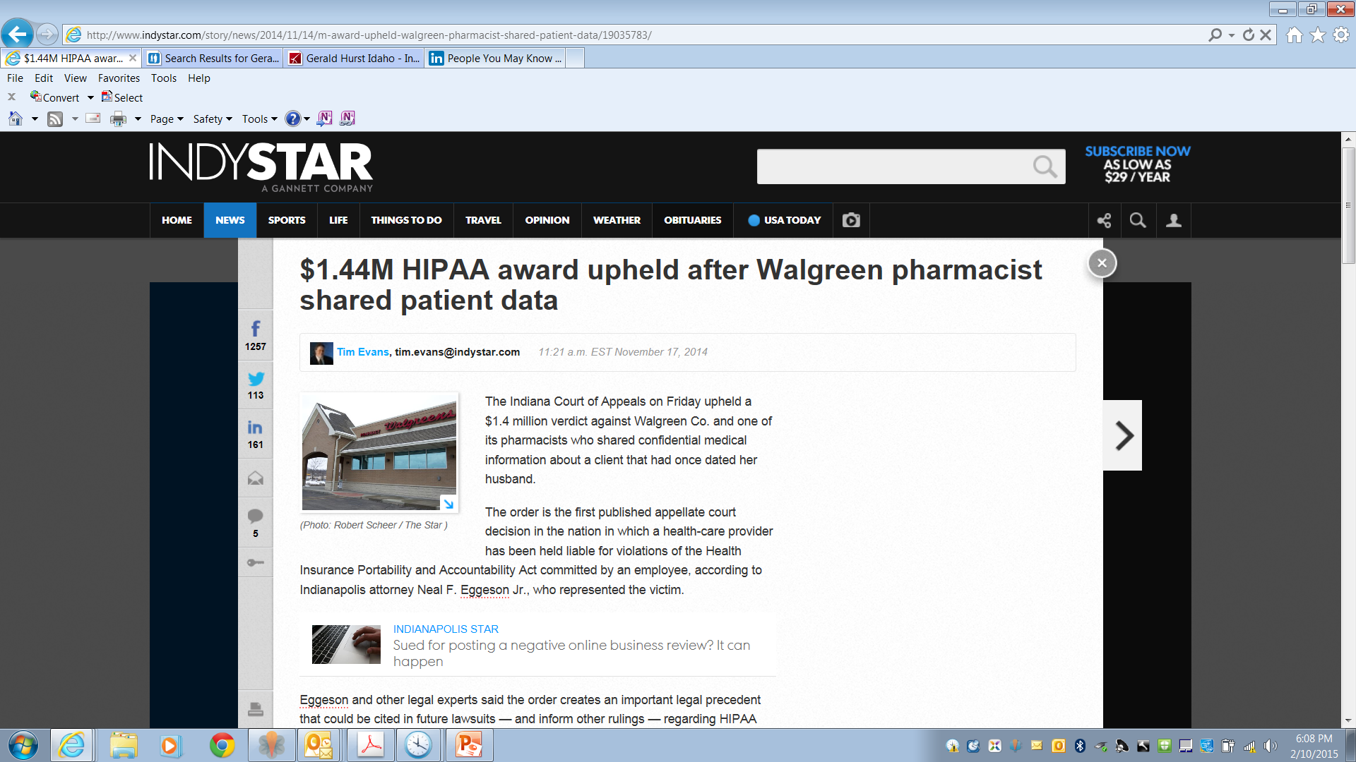


Slide 13

Who and What Does it Cover?

Slide 14
Entities Subject to HIPAA
Covered entities
  Health care providers who engage in certain electronic transactions.
  Health plans, including employee group health plans if:
    50 or more participants; or
    Administered by third party (e.g., TPA or insurer).
  Health care clearinghouses.
Business associates of covered entities
  Entities with whom you share PHI to perform services on your behalf.

Slide 15
Protected Health Information
Protected health info (“PHI”) =
  Individually identifiable health info, i.e., info that could be used to identify individual.
  Concerns physical or mental health, health care, or payment.
  Created or received by covered entity in its capacity as a healthcare provider.
  Maintained in any form or medium, e.g., oral, paper, electronic, images, etc.
Not de-identified info.

Slide 16


Prohibited Actions
Unauthorized disclosure outside covered entity.
Unauthorized use within covered entity.
Unauthorized access within covered entity.

Slide 17

Use and Disclosure Rules
(45 CFR 164.502-.514)

Slide 18
Use and Disclosure Rules
Cannot use or disclose PHI unless—
  For purposes of treatment, payment, or healthcare operations.
  For disclosures to family members and others involved patients care or payment for care if:
    Patient has not objected,
    Disclosure appropriate under circumstances, and
    Limit disclosure to person’s involvement.
  For certain safety or government purposes as listed in 45 CFR 164.512.
  Have a valid written authorization signed by patient that complies with 45 CFR 164.508.

Slide 19
Treatment, Payment or Operations
May use or disclose PHI without patient’s authorization for:
  Treatment
  Payment
  Health care operations
  Except psychotherapy notes.
If agree with patient to limit use or disclosure for treatment, payment, or healthcare operations, you must abide by that agreement except in an emergency.
  Don’t agree! It increases liability.
(45 CFR 164.506 and 164.522)

Slide 20
Persons Involved in Care
May use or disclose PHI to family or others involved in patient’s care or payment for care if conditions met.
  If patient present, may disclose if:
    Patient agrees to disclosure or has chance to object and does not object, or
    Reasonable to infer agreement from circumstances.
  If patient unable to agree, may disclose if:
    Patient has not objected; and
    You determine it is in the best interest of patient.
  Limit disclosure to scope of person’s involvement.
Applies to disclosures after the patient is deceased.
(45 CFR 164.510)

Slide 21
Safety and Govt Functions
Authorization is not required if certain regulatory conditions are satisfied.
  Avoid serious and imminent threat
  Another law requires disclosure
  Per court order, warrant or subpoena
  Law enforcement if conditions satisfied
  Public health activities
  Health oversight activities
  Workers compensation
  Coroners
  Persons in custody
  Military purposes
Check with privacy officer or 42 CFR 164.512 to determine if conditions are satisfied.
(45 CFR 164.512)

Slide 22
Authorization
May use or disclose PHI if have valid written authorization signed by patient or their personal representative.
Authorization must contain elements and statements required in 45 CFR 164.508.
Cannot combine HIPAA authorization with other consents or documents.
Certain uses or disclosures require authorization.
  Psychotherapy notes, except provider’s use of own notes for treatment purposes.
  For marketing purposes.
  For sale of protected info.
(45 CFR 164.508)

Slide 23
Verification
Before disclosing PHI:
  Verify the identity and authority of person requesting info if he/she is not known.
    E.g., check the badge or papers of officers; birthdates or SSN for family; etc.
  Obtain any documents, representations, or statements required to make disclosure.
    E.g., written satisfactory assurances accompanying a subpoena, or representations from police that they need info for immediate identification purposes.
(45 CFR 164.512(f))

Slide 24
Minimum Necessary Standard
Cannot use or disclose more than is reasonably necessary for intended purpose.
Does not apply to disclosures to:
  Patient
  Provider for treatment
  Per individual’s authorization
Must have policies regarding
  Role-based access
  Routine disclosures and requests for info
(45 CFR 164.502 and .514)

Slide 25
Personal Representatives
Under HIPAA, you must treat the personal rep as if they were the patient.
Personal reps generally have right to exercise patient rights, e.g.,
  Request restrictions on use or disclosure of protected info.
  Access protected info.
  Amend protected info.
  Obtain accounting of disclosures of protected info.
Personal rep = persons with authority under state law to:
  Make healthcare decisions for patient.
  Make decisions for deceased patient’s estate.
(45 CFR 164.502(g))

Slide 26
Personal Representatives
Not required to treat personal rep of minor (i.e., do not disclose protected info to them) if:
  Minor has authority to consent to care.
  Minor obtains care at the direction of a court or person appointed by the court.
  Parent agrees that provider may have a confidential relationship.
  Provider determines that treating personal rep as the patient is not in the best interest of patient, e.g., abuse.

Slide 27
Disclosures to Family and Personal Representatives
Potential bases for disclosure
  Personal rep has right to access protected info.
  Disclosure for treatment, payment or health care operations.
  Disclosure to family members or others involved in care or payment if:
    Patient did not object,
    In patient’s best interests, and
    Limit disclosure to scope of person’s involvement.
  Other HIPAA exception.

Slide 28

Business Associates
(45 CFR 164.502 and .504)
I am your Business Associate

Slide 29
Business Associates
May disclose PHI to business associate if you have valid business associate agreement.
  Requires business associate to comply with certain HIPAA requirements.
  Must contain required elements.
Business associate = someone you want to create, maintain, or access PHI for you.

Slide 30
Business Associates
Business Associates
Management company
Billing company
EMR / IT specialist
Consultant
Accountant
Attorney
Malpractice insurer
Interpreters
Data storage entities
Data transmission services if have routine access to info
Subcontractors of forgoing
NOT Business Associates
Workforce members, i.e., if you have right to control
Other providers when they are providing treatment
Members of organized healthcare arrangement
Insurance companies unless acting for you
Mere conduits of information, e.g., mailman
Janitors

Slide 31
Business Associates
Covered entity is liable for acts of business associate if:
  Knew or should know that business associate is violating HIPAA and covered entity fails to act; or
  Business associate is the covered entity’s agent.
Make sure business associate is an independent contractor, not an agent.
  Business associate agreement should confirm same.
  Make sure you do not control method and manner of business associate’s functions.

Slide 32

HIPAA Security Rule
(45 CFR 164.300 et seq.)

Slide 33
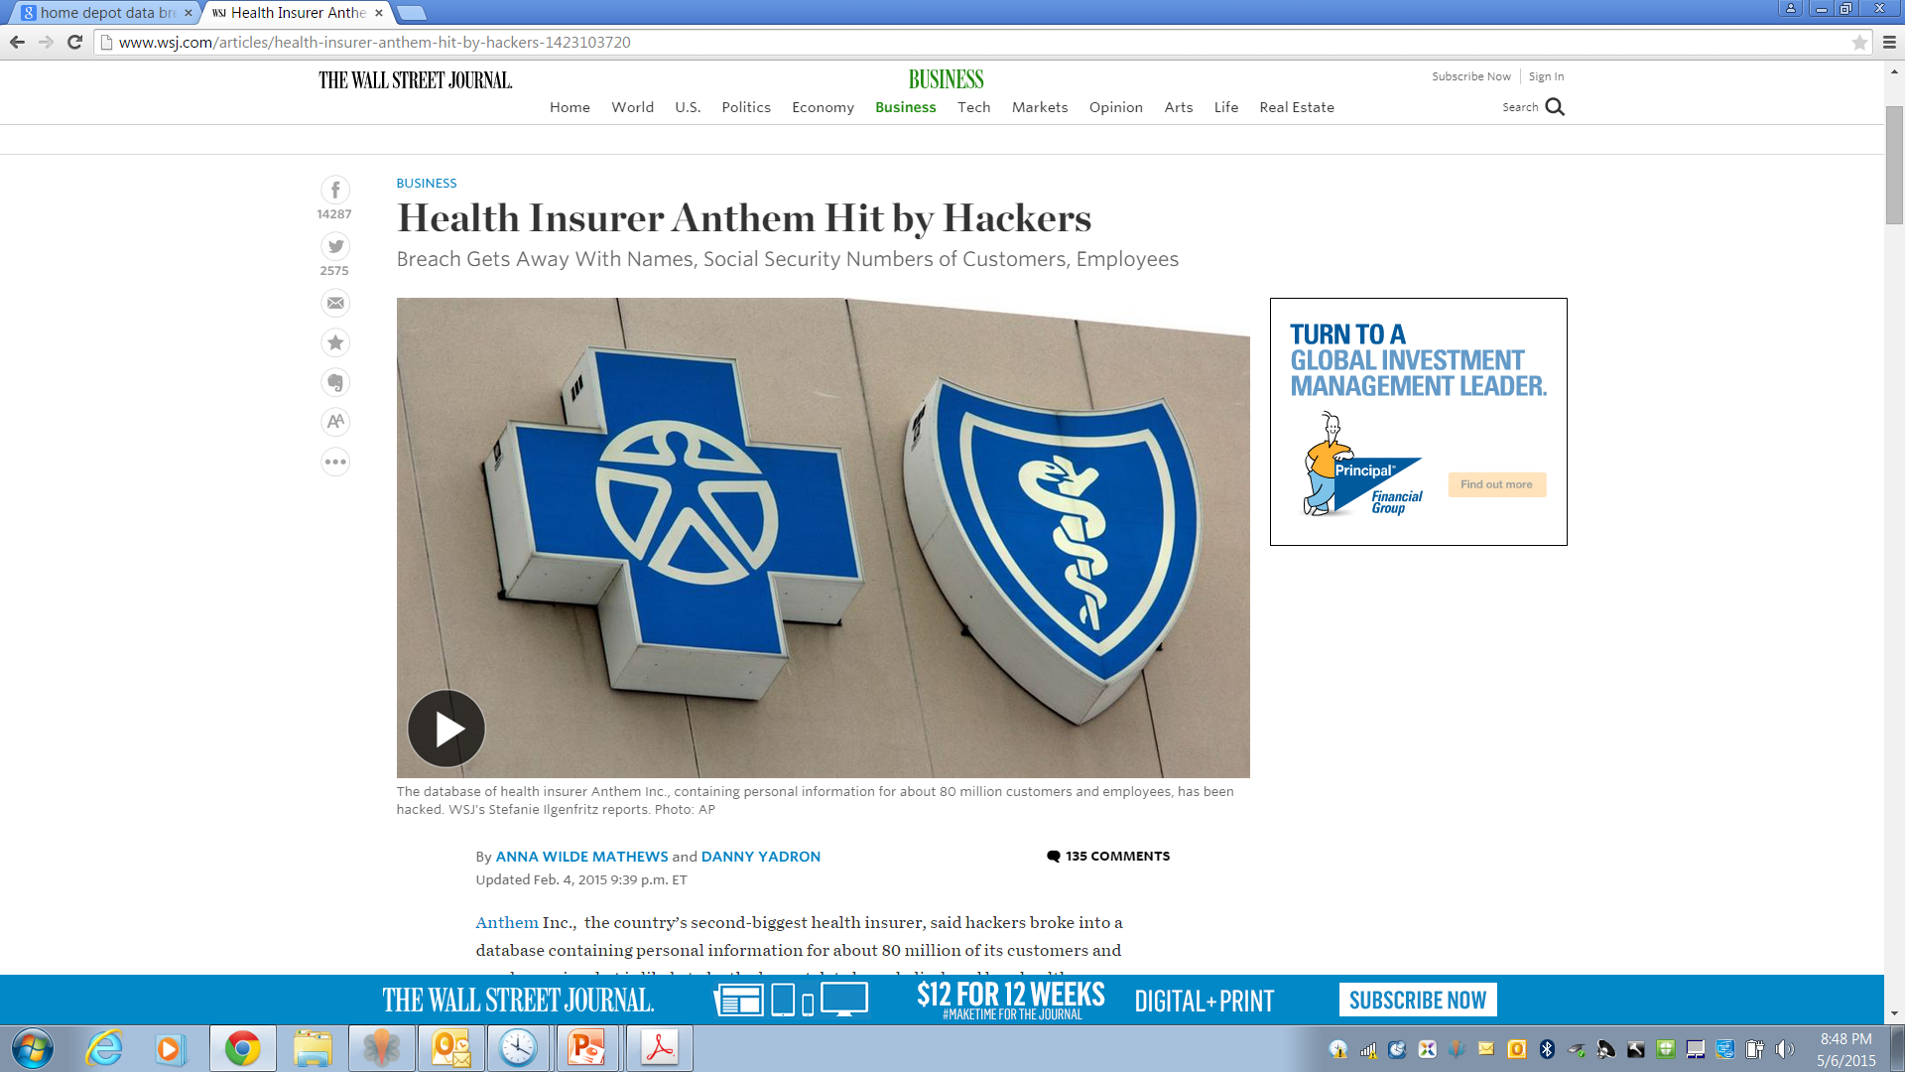

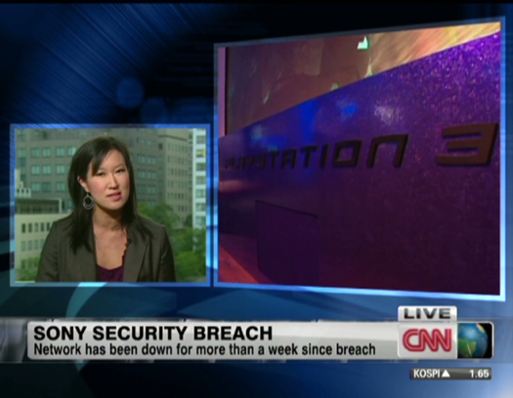

Slide 34
Civil Penalties (2014)
Anchorage Community Mental Health Services pays $150,000 for failing to maintain patches on software.
New York hospitals pay $4.8 million for leaving electronic medical records vulnerable to searches.
Concentra pays $1.7 million for lost unencrypted laptop.
QCA Health Plan pays $250,000 for lost unencrypted laptop.
Skagit County, WA pays $215,000 because PHI was available on public database.
Parkview Community Health: fined $800,000 for leaving 71 boxes of records in physician’s driveway.
All involved security rule violations

Slide 35
Security Rule
Conduct risk analysis.
Implement safeguards.
  Administrative
  Technical
  Physical
Execute business associate agreements.
Intended to ensure:
Confidentiality
Integrity
Availability
of ePHI.

Slide 36
Security Rule Compliance
Administrative
Safeguards
Physical
Safeguards
Technical
Safeguards
Standards
Standards
Standards
Implementation
Specifications
Required
Addressable
Implementation
Specifications
Required
Addressable
Implementation
Specifications
Required
Addressable

Slide 37
Administrative Safeguards
Security management process
Assigned security responsibility
Workforce security
Information access management
Security awareness and training
Security incident procedures
Contingency plan
Evaluation
Business associate contracts

Slide 38
Physical Safeguards
Facility access controls
Workstation use
Workstation security
Device and media controls

Slide 39
Technical Safeguards
Access controls
Audit controls
Integrity of e-PHI
Person or entity authorization
Transmission security

Slide 40
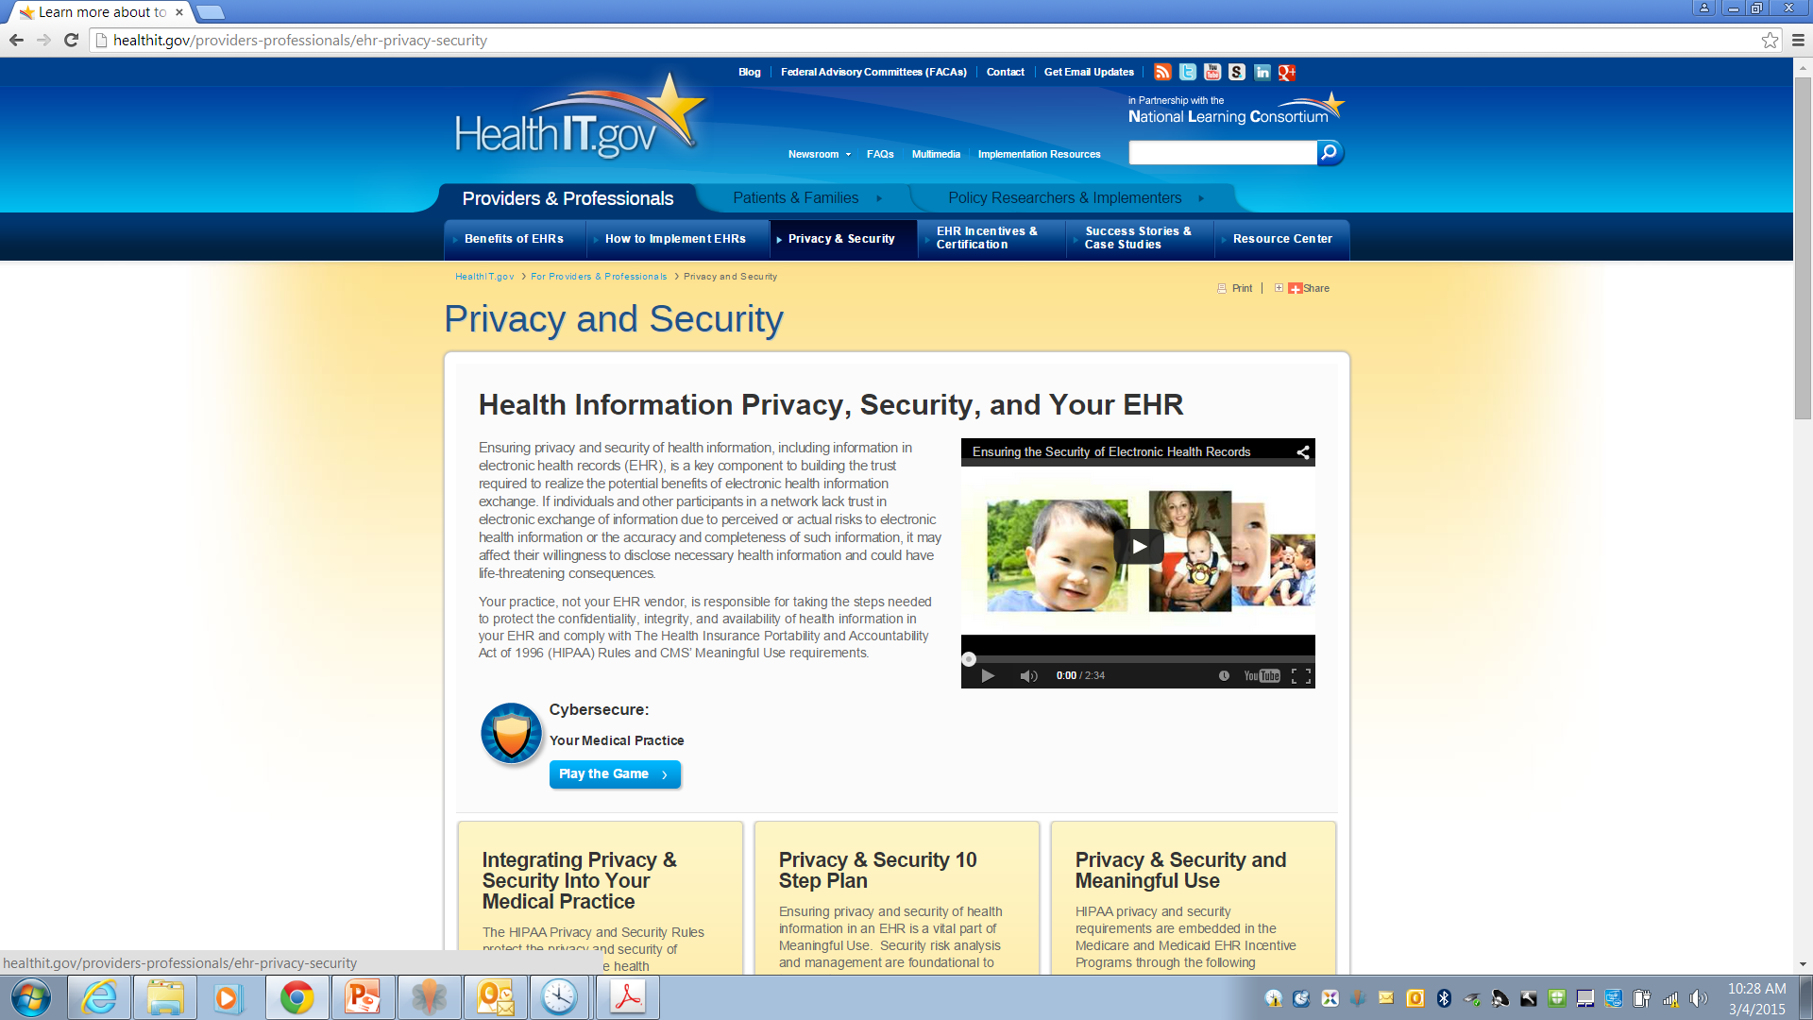
Data Privacy and Security

Slide 41
Risk Analysis
Security rule requires that covered entities and business associates “conduct an accurate and thorough assessment of the potential risks and vulnerabilities to the confidentiality, integrity and availability of [ePHI]…” (45 CFR 164.308(a)).
  Frequently cited in recent violations.
Periodically reevaluate analysis.
  New systems or equipment.
  Every few (very few?) years.
  Include mobile devices.

Slide 42
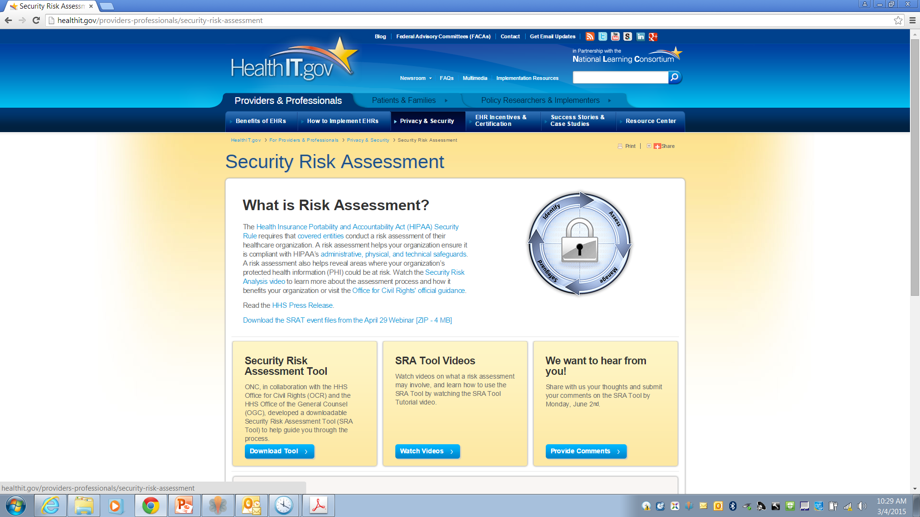

Slide 43
Risk Analysis
Additional materials are available at www.hhs.gov/ocr/privacy/hipaa/administrative/securityrule/securityruleguidance.html
  Final Guidance on Risk Analysis
  OCR Guidance re Risk Analysis
  NIST Publications

Slide 44
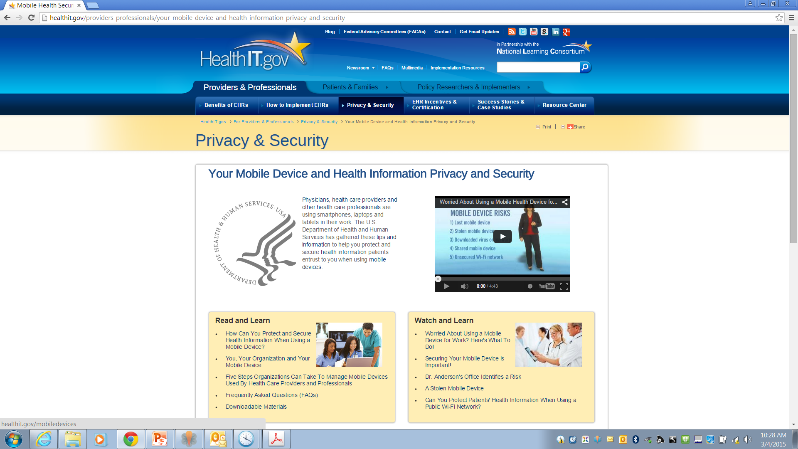

Slide 45
Encryption
Encryption is an addressable standard per 45 CFR 164.312:
  (e)(1) Standard: Transmission security. Implement technical security measures to guard against unauthorized access to [ePHI] that is being transmitted over an electronic communications network.
  (2)(ii) Encryption (Addressable). Implement a mechanism to encrypt electronic protected health information whenever deemed appropriate.
ePHI that is properly encrypted is “secured”.
  Not subject to breach reporting.
OCR presumes that loss of unencrypted laptop, USB, mobile device is breach.

Slide 46
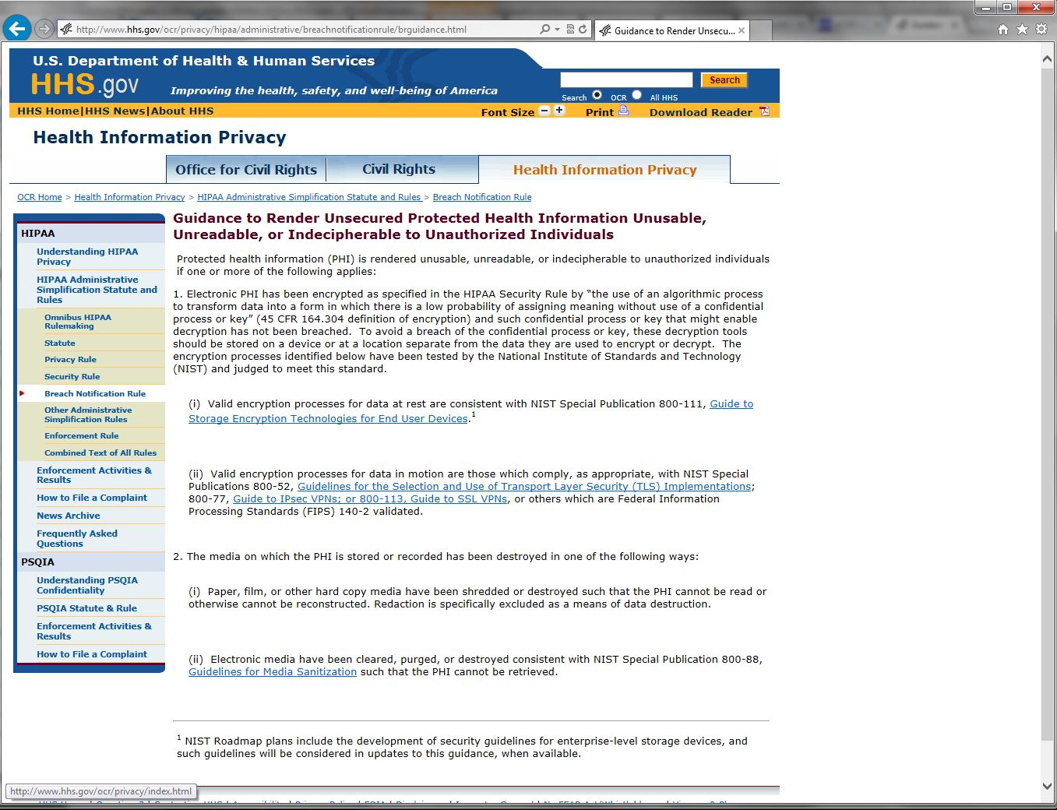

Slide 47
Communicating by E-mail or Text
HIPAA Privacy Rule allows patient to request communications by alternative means or at alternative locations.
  Including unencrypted e-mail.
(45 CFR 164.522(b))
Omnibus Rule commentary states that covered entity or business associate may communicate with patient via unsecured e-mail so long as they warn patient of risks and patient elects to communicate via unsecured e-mail to text.
(78 FR 5634)

Slide 48
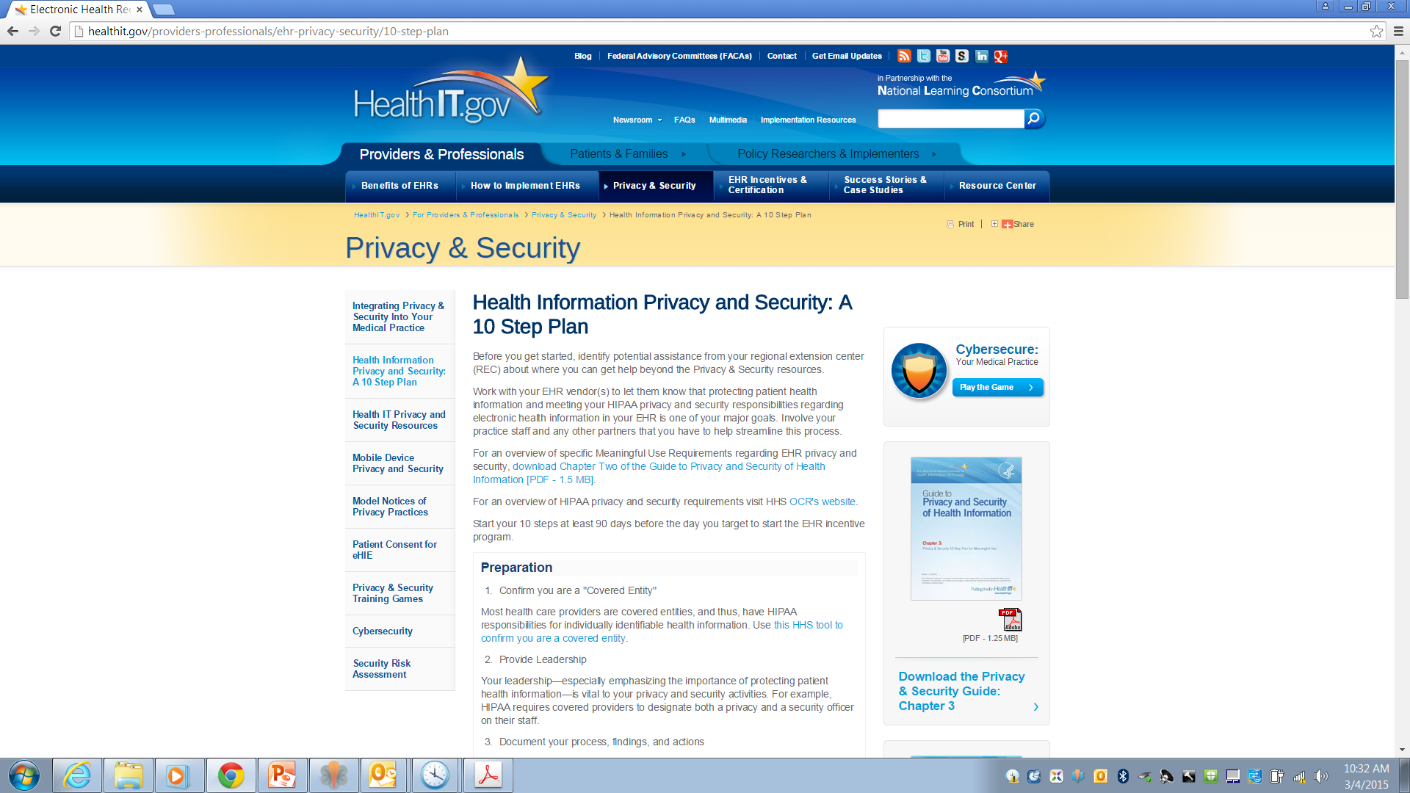

Slide 49
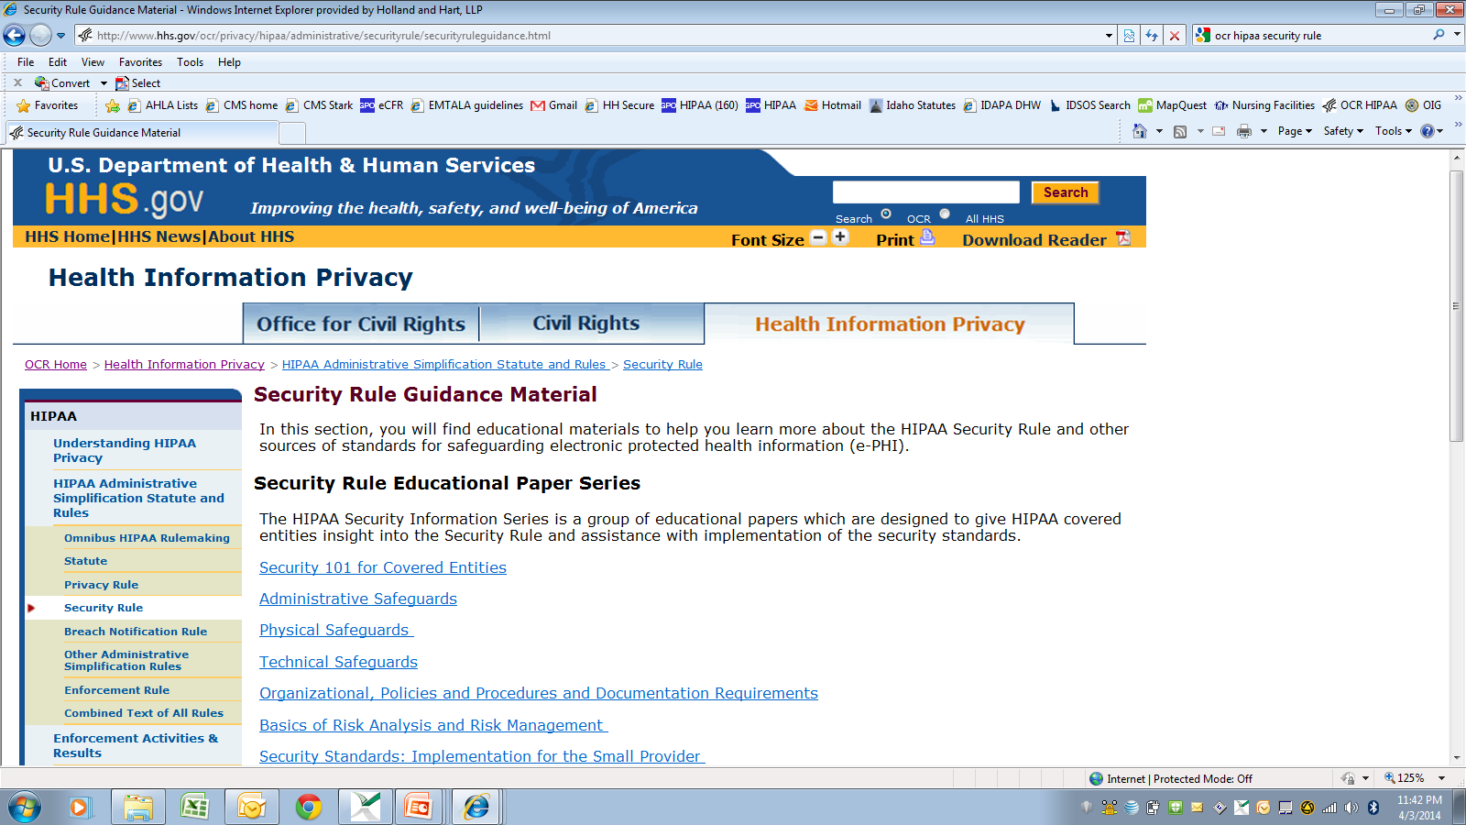

Slide 50

HIPAA Patient Rights
(45 CFR 164.520-.528)

Slide 51
Individual Rights
Right to receive notice of privacy practices.
Right to request additional restrictions on use or disclosure for treatment, payment or operations.
Right to receive information by alternative means or at alternative location.
Right to access protected health information.
Right to request amendment of protected health information.
Right to limited accounting of disclosures.

Slide 52
Notice of Privacy Practices
Notice summarizes HIPAA rules and explains how you will use the patient’s information.
Direct treatment providers:
  Give copy to patients by first date of treatment.
  Post notice in “prominent locations”
  Post notice on website.
  Make good faith attempt to obtain acknowledgment of receipt.
(45 CFR 164.520)

Slide 53
Request Restrictions on Use or Disclosure
Individual has right to request additional restrictions on use or disclosure for treatment, payment and operations.
Covered entity may generally decline restrictions.
  DON’T AGREE!
If covered entity agrees to additional restrictions, it must abide by them unless:
  Emergency, or
  Disclosure required by regulations.
Covered entity may terminate the agreement for additional restrictions prospectively.
(45 CFR 164.522)

Slide 54
Restrictions on Disclosures to Health Insurers
Per omnibus rule, must agree to request of a patient to restrict disclosure of protected info to a health plan if:
  Protected info pertains to health care item or service for which the patient, or another person on the patient’s behalf, paid the covered entity in full; and
  Disclosure is for the purpose of carrying out payment or health care operations and is not otherwise required by law.
Don’t ask the patient!
(45 CFR 164.522)

Slide 55
Request Alternative Communications
Must accommodate reasonable request to receive info by alternative means or at alternative locations.
  May require written request.
  May not require explanation.
  May require info as to how payment will be handled.
(45 CFR 164.522(b))

Slide 56
Access PHI
Patient or personal rep generally has right to inspect and obtain copy of PHI in “designated record set, i.e., documents used to make decisions concerning healthcare or payment.
Must respond within 30 days.
Must provide records in requested form if readily producible, including electronic form.
May require written request.
May charge reasonable cost-based fee, i.e., cost of actual labor and materials in making copies, not administrative or retrieval fee.
Check with privacy officer or review 45 CFR 164.524 before denying request.
(45 CFR 164.524)

Slide 57
Request Amendment
Individual has right to request amendment.
Covered entity may deny request if:
  Record not part of designated record set.
  Entity did not create the record unless creator no longer available.
  Record is accurate and complete.
Must act on request within 60 days.
If accept request, amend record accordingly.
If deny request, notify patient of basis for denial.
  Patient has right to have request become part of record.
Check with privacy officer or review 45 CFR 164.526 when responding to requests.
(45 CFR 164.526)

Slide 58
Accounting of Disclosures
Individual may obtain accounting of certain disclosures made for prior 6 years.
  Improper disclosures.
  Disclosures for certain safety or govt functions under 45 CFR 164.512.
Must maintain log of disclosures, including:
  Date of disclosure.
  Name of entity receiving disclosure.
  Description of info disclosed.
  Describe purpose of disclosure.
Must account for disclosures by business associates.
Check with privacy officer.
(45 CFR 164.528)

Slide 59

Breach Notification
(45 CFR 164.400 et seq.)

Slide 60
Breach Notification
If there is breach of unsecured protected info,
  Covered entity must notify:
    Each individual whose unsecured info has been or reasonably believed to have been accessed, acquired, used, or disclosed.
    HHS.
    Media, if breach involves > 500 persons in a state.
  Business associate must notify covered entity.
(45 CFR 164.400 et seq.)

Slide 61
Breach
Acquisition, access, use or disclosure of protected health info in violation of privacy rules is presumed to be a breach unless the covered entity or business associate demonstrates that there is a low probability that the info has been compromised based on a risk assessment of the following factors:
  nature and extent of PHI involved;
  unauthorized person who used or received the PHI;
  whether PHI was actually acquired or viewed; and
  extent to which the risk to the PHI has been mitigated.
  unless an exception applies.
  (45 CFR 164.402)

Slide 62
If you think you have a breach
Act immediately to mitigate or correct the breach.
  Retrieve the PHI.
  Confirm that PHI has not been improperly accessed, used or disclosed, or if it has, obtain assurance that no further disclosure.
Notify privacy officer immediately.
Correct any process that resulted in improper disclosures.
Conduct additional training.
Remember: prompt action may allow provider to—
  Satisfy its duty to mitigate.
  Avoid disclosure and breach reporting obligation.
  Defend against HIPAA penalties.

Slide 63

Administrative Requirements
(45 CFR 164.530)

Slide 64
Administrative Requirements
Designate privacy and security officers.
Train workforce.
Implement written policies and procedures.
Respond to complaints and violations.
Mitigate improper disclosures.
Maintain documentation for 6 years.
Implement reasonable safeguards.
  “Incidental disclosures” do not violate HIPAA.
(45 CFR 164.530)

Slide 65

Action Items
HIPAA Top 10 List

Slide 66
HIPAA Action Items
1. Assign and document HIPAA responsibility.
  Privacy officer
  Security officer
2. Ensure the officers understand the rules.
3. Review security rule compliance.
  Conduct and document security risk assessment.
  Beware electronic devices.
4. Ensure you have required policies.
  Privacy rule.
  Security rule.
  Breach notification rule.

Slide 67
HIPAA Action Items
5. Develop and use compliant forms.
  Authorization, privacy notice, patient requests, etc.
6. Execute BAAs with business associates.
  Ensure they are independent contractors.
  Follow up if there are problems with business associate.
7. Train members of workforce and document training.
  Upon hiring.
  Periodically thereafter.
8. Use appropriate safeguards.
  Confidentiality agreements with workforce members.
  Reasonable administrative, technical and physical safeguards

Slide 68
HIPAA Action Items
9. Respond immediately to any potential breach.
  Immediately take appropriate steps to mitigate.
  Retrieve PHI.
  Obtain assurances of no further use or disclosure.
  Warn of penalties of violations.
  Investigate facts to determine if there was a reportable breach.
  Sanction workforce member as appropriate.
  Implement corrective action, additional training, etc.
  Document foregoing.
10. Timely report breaches as required.
  To patient or personal representative.
  To HHS

Slide 69

Additional Resources

Slide 70
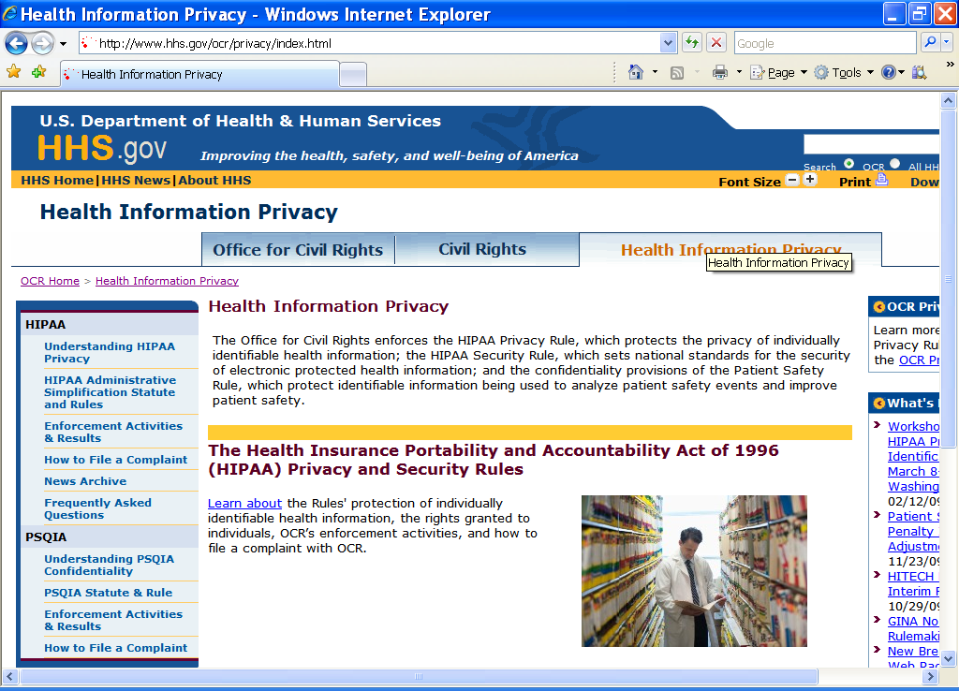
www.hhs.gov/ocr/privacy

Slide 71
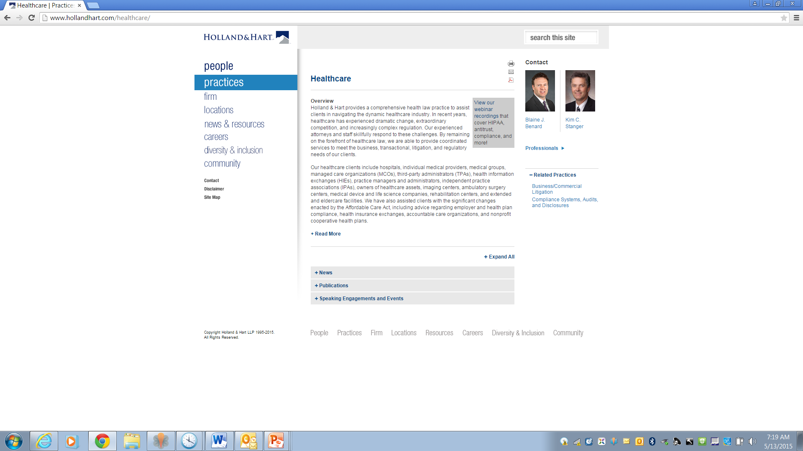
Webinars
Publications

Slide 72

Questions?
Kim C. Stanger
(208) 383-3913
(208) 409-7907 (cell)
kcstanger@hollandhart.com
Melissa Starry
(208) 383-3984
(208) 598-4001
mmstarry@hollandhart.com

