Slide 1

Fraud and Abuse Laws
Kim C. Stanger
Compliance Bootcamp
(5/15)

Slide 2
This presentation is similar to any other legal education materials designed to provide general information on pertinent legal topics. The statements made as part of the presentation are provided for educational purposes only. They do not constitute legal advice nor do they necessarily reflect the views of Holland & Hart LLP or any of its attorneys other than the speaker. This presentation is not intended to create an attorney-client relationship between you and Holland & Hart LLP. If you have specific questions as to the application of law to your activities, you should seek the advice of your legal counsel.

Slide 3

Overview
Key fraud and abuse laws
  False Claims Act
  Anti-Kickback Statute
  Ethics in Physician Referrals Act (“Stark”)
  Civil Monetary Penalties Law
  Idaho Statutes
Report and repayment obligations
Compliance programs

Slide 4

False Claims Act (18 USC 1347)

Slide 5
False Claims Act
Cannot knowingly submit a false claim for payment to the federal government.
Must report and repay an overpayment within 60 days.
Penalties
  Repayment plus interest
  Civil monetary penalties of $5,500 to $11,000 per claim
  3x damages
  Exclusion from Medicare/Medicaid
(18 USC 1347)

Slide 6
False Claims Act
Qui Tam Suits: private entities (e.g., employees, patients, providers, competitors, etc.) may sue the hospital under False Claims Act on behalf of the government.
  Government may or may not intervene.
  Qui tam relator.
    Receives a percentage of any recovery.
    Recovers their costs and attorneys fees.

Slide 7
False Claims Act: Examples
Claims for services that were not provided or were different than claimed.
Failure to comply with quality of care.
  Express or implied certification of quality.
  Provision of “worthless” care.
Failure to comply with conditions of payment or relevant fraud and abuse laws.
  Express or implied certification of compliance when submit claims (e.g., cost reports or claim forms).

Slide 8
Idaho False Claims Act
Cannot knowingly:
  Submit claim that is incorrect.
  Make false statement in any document submitted to state.
  Submit a claim for medically unnecessary service.
Penalties
  Exclusion from state health programs, e.g., Medicaid.
  Civil penalty of up to $1000 per violation.
  Referral to Medicaid fraud unit.
(IC 56-209h(6))

Slide 9

Anti-Kickback Statute (42 USC 1320a-7b; 42 CFR 1001.952)

Slide 10
Anti-Kickback Statute
Cannot knowingly and willfully offer, pay, solicit or receive remuneration to induce referrals for items or services covered by government program unless transaction fits within a regulatory safe harbor.
(42 USC 1320a-7b(b))
“One purpose test”
  Anti-Kickback Statute applies if one purpose of the remuneration is to induce referrals even if there are other legitimate purposes. (U.S. v.Greber, 760 F.2d 68 (3d Cir. 1985)).
  Difficult to disprove.
Ignorance of the law is no excuse.

Slide 11
Anti-Kickback Statute
Penalties
  5 years in prison
  $25,000 criminal fine
  $50,000 penalty
  3x damages
  Exclusion from Medicare/Medicaid
(42 USC 1320a-7b(b); 42 CFR 1003.102)
Anti-Kickback violation = False Claims Act violation
  Lower standard of proof
  Subject to False Claims Act penalties
  Subject to qui tam suit.
(42 USC 1320a-7a(a)(7))
OIG Self-Disclosure Protocol: minimum $50,000 settlement.

Slide 12

Anti-Kickback Statute
Anytime you want to:
Give or receive anything to induce or reward referrals, or
Do any deal with a referral source.

Slide 13
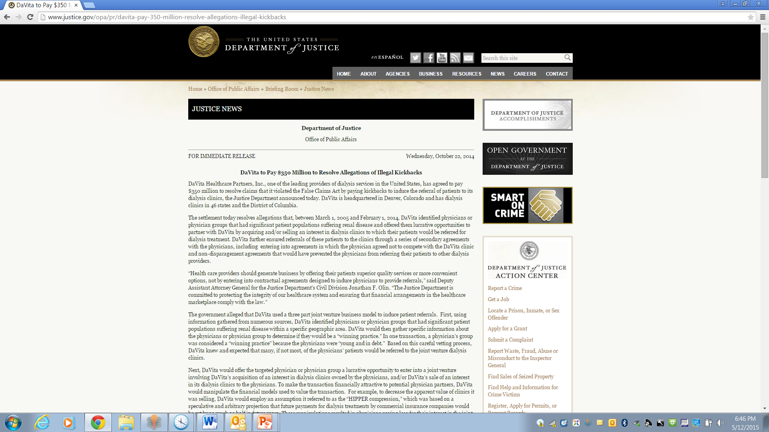

Slide 14


Who Wants to Pay a
Million to Medicare?

Slide 15
Which of the following violates the Anti-Kickback Statute?
Paying a referring physician more than fair market value for medical director or other services?
Charging a referring physician less than fair market value to use your space or equipment?
Hiring a referring physician to act as a consultant even though you really do not need one?
Sending a “thank you” gift to referring providers or their offices?
If “one purpose” is to induce referrals for items or services for federal program business.

Slide 16
Which of the following violates the Anti-Kickback Statute?
Giving gifts or other freebies to Medicare or Medicaid beneficiaries?
Waiving copays and deductibles or providing “insurance only” billing to Medicare or Medicaid beneficiaries without a showing of financial need?
Accepting free trips or other gifts from vendors or other providers to whom you refer?
Giving your attorney a generous appreciation gift because of the joy they bring to you?
If “one purpose” is to induce referrals for items or services for federal program business.

Slide 17
Anti-Kickback Statute
Applies to any form of remuneration to induce or reward referrals for federal program business.
  Money.
  Free or discounted items or services (e.g., perks, gifts, space, equipment, meals, insurance, trips, CME, etc.).
  Overpayments or underpayments (e.g., not fair market value).
  Payments for items or services that are not provided.
  Payments for items or services that are not necessary.
  Professional courtesies.
  Waivers of copays or deductibles.
  Low interest loans or subsidies.
  Business opportunities that are not commercially reasonable.
  Anything else of value…

Slide 18
Anti-Kickback Statute:
Safe Harbors
No liability if satisfy all the requirements of a safe harbor.
Not required to fit within safe harbor because ultimate question is whether “one purpose” of remuneration is to induce or reward referrals.
The closer you come to satisfying regulatory requirements, the safer you will be.

Slide 19
Anti-Kickback Statute:
Safe Harbors
Exceptions and safe harbors
  Bona fide employment
  Personal services contracts
  Leases for space or equipment
  Investments in group practice
  Investments in ASCs
  Sale of practice
  Recruitment
  Certain investment interests
  Waiver of beneficiary coinsurance and deductible amounts.
(42 CFR 1001.952)

Slide 20
Anti-Kickback Statute:
Safe Harbors
Exceptions and safe harbors (cont.)
  OB malpractice insurance subsidies
  Referral services
  Referral arrangements for specialty services
  Warranties
  Discounts
  Group purchasing organizations
  Price reductions offered to health plans and MCOs
  Ambulance replenishing
  Health centers
  Electronic health record items or services
(42 CFR 1001.952)

Slide 21
Anti-Kickback Statute
No de minimus safe harbor.
  But not too much risk if remuneration is negligible.
No “fair market value” safe harbor.
  “Fair market value” payment does not legitimize a payment if there is an illegal purpose. (70 FR 4864)
  But fairly safe if remuneration represents fair market value for legitimate, needed services or items.
Consider risk of federal program abuse.
  Due to nature of transaction.
  Incorporate safeguards to protect against abuse.

Slide 22
Advisory Opinions
OIG may issue advisory opinions.
  Listed on OIG fraud and abuse website, www.oig.hhs.gov/fraud.
Not binding on anyone other than participants to the opinion.
But you are probably fairly safe if you act consistently with favorable advisory opinion.

Slide 23
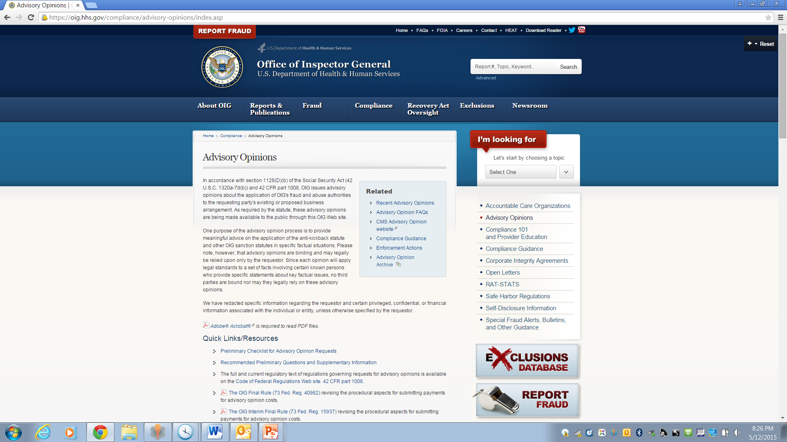

Slide 24
Idaho Anti-Kickback Statute
Service provider (including providers of healthcare services) cannot:
  Pay another person, or other person cannot accept payment, for a referral.
  Provide services knowing the claimant was referred in exchange for payment.
  Engage in regular practice of waiving, rebating, giving or paying claimant’s deductible for health insurance.
Penalties
  $5000 fine by Department of Insurance
(IC 41-348)

Slide 25
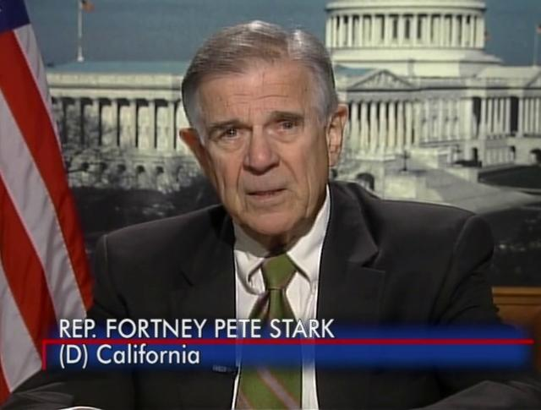
Ethics in Patient Referrals Act (“Stark”) (42 USC 1395nn)
Regulations at 42 CFR 411.350-.389

Slide 26
Stark
If a physician (or their family member) has a financial relationship with an entity:
  The physician may not refer patients to that entity for designated health services, and
  The entity may not bill Medicare for such designated health services
unless arrangement structured to fit within a regulatory exception.
(42 CFR 411.353)

Slide 27


Stark
Financial Relationship w/physician or family
Referrals for DHS
Physician cannot refer and DHS provider cannot bill for DHS unless transaction fits in safe harbor.

Slide 28
Stark
Penalties
  No payment for services provided per improper referral.
  Repayment of payments improperly received within 60 days.
  Civil penalties.
    $15,000 per claim submitted
    $100,000 per scheme
(42 CFR 411.353, 1001.102(a)(5), and 1001.103(b))
May also constitute Anti-Kickback Statute violation
May trigger False Claims Act.

Slide 29
Stark
Cannot bill or receive payment for services for prohibited referrals during the “period of disallowance.”
  Begins when financial relationship fails to satisfy one of the safe harbors.
  Ends when:
    Relationship brought into compliance, and
    Amounts overpaid or underpaid are repaid.
Prospective compliance alone does not end the period of noncompliance.
(42 CFR 411.353(c)(1))

Slide 30
Stark
Any financial relationship or item of value between a physician (or their family) and an entity providing DHS.

Slide 31
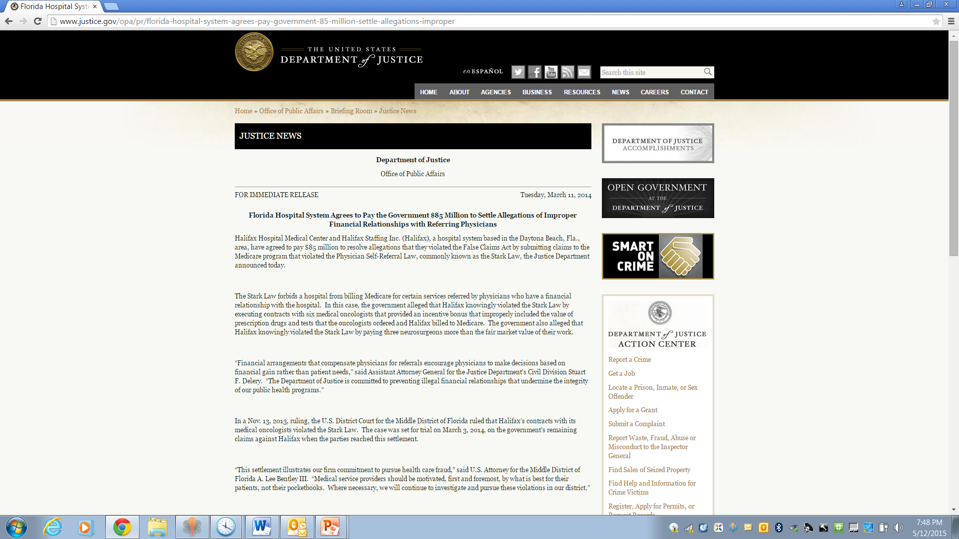

Slide 32
Stark
Applies to referrals by a physician to entities with which the physician (or their family member) has a financial relationship.
Physician =
  MDs
  DOs
  Oral surgeons
  Dentists
  Podiatrists
  Optometrists
  Chiropractors
(42 CFR 411.351)
Family member =
  Spouse
  Parent, child
  Sibling
  Stepparent, stepchild, stepsibling
  Grandparent, grandchild
  In-law

Slide 33
Stark
Applies to referrals by physician to entities with which physician (or their family member) has financial relationship.
  Direct relationship.
  Indirect relationship (e.g., through ownership in another entity).
Financial relationship =
  Ownership or investment: stocks, bonds, partnership, membership shares, secured loans, securities, etc.
  Compensation: employment, contract, lease, payments, gifts, free or discounted items, and virtually any other exchange of remuneration.
(42 CFR 411.351 and .354)

Slide 34
Stark
Applies to referrals (orders, requests, plan of care, certification) by physician for DHS performed by others.
  Other providers or facilities.
  Others in physician’s own group.
  Other employees or contractors.
Does not apply to services the physician personally performs.
  Physician may perform his own DHS.
  Beware ancillary, technical, facility fees.
Does not apply to many services performed by radiologists or pathologists since they usually do not make “referrals”.
(42 CFR 411.351)

Slide 35
Stark
Applies to referrals for designated health services (“DHS”) payable in whole or part by Medicare.
  Inpatient and outpatient hospital services
  Outpatient prescription drugs
  Clinical laboratory services
  Physical, occupational, or speech therapy
  Home health services
  Radiology and certain imaging services
  Radiation therapy and supplies
  Durable medical equipment and supplies
  Parenteral and enteral nutrients, equipment, and supplies
  Prosthetics and orthotics
CMS website lists some of the affected CPT codes.
(42 CFR 411.351)

Slide 36
Stark
Stark does not require intent to violate statute.
  No “good faith” compliance.
To comply with Stark, transaction must either:
  Fall outside statute, i.e., no “financial relationship” or “referral”, or
  Fit within regulatory safe harbor.
Exception: Entity may bill for prohibited services rendered per improper referral if entity did not know and did not act in reckless disregard or deliberate indifference concerning the identity of the referring physician.
(42 CFR 411.353)

Slide 37
Stark: Safe Harbors
Stark contains numerous safe harbors.
  Applicable to both ownership/investment and compensation arrangements.
  Applicable to only ownership/investment arrangements.
  Applicable to only compensation arrangements.
No liability if comply with all the requirements of an applicable safe harbor.
Need only comply with one safe harbor for each financial relationship.
(42 CFR 411.355-.357)

Slide 38
Stark: Exceptions for Both Ownership and Compensation
Physician services rendered by another physician in same group practice* or under such physician’s supervision.
In-office ancillary services provided through group practice*.
Prepaid health plans.
Certain services furnished in academic medical center.
Implants in ASC.
Preventive screening tests, immunizations, and vaccines.
EPO and other dialysis-related drugs.
Eyeglasses and contact lenses following cataract surgery.
Intra-family rural referrals.
(42 CFR 411.355)
* Must qualify as “group practice” under 42 CFR 411.352.

Slide 39
Stark: Exceptions for Only Ownership or Investments
Ownership or investment interests in:
Rural providers.
The whole hospital, not a part of the hospital.
  Subject to limits in 42 CFR 411.362.
Publicly traded securities.
Large, regulated mutual funds.
(42 CFR 411.356)

Slide 40
Stark: Exceptions for Only Compensation Arrangements
Bona fide employment relationships.
Personal services contracts.
Office space or equipment rental.
Physician recruitment.
Physician retention.
Remuneration unrelated to DHS.
Fair market value.
(42 CFR 411.357)
Non-monetary compensation up to $300.
Medical staff incidental benefits.
Compliance training.
Community-wide health information system.
Professional courtesy.
Certain payments by a physician for items or services at FMV.
Others.

Slide 41
Stark: Analysis
Is there a financial relationship between the DHS provider and the physician or their family member?
    Direct or indirect relationship?
    Ownership or investment interest?
    Compensation arrangement?
2. Does the physician make or has she made referrals to the entity for DHS payable by Medicare?
3. Does a safe harbor apply?
4. Has the entity billed for items/services pursuant to improper referral, and if so, did the entity have knowledge of physician’s identity?

Slide 42
Stark: Common Problems
Physician referrals to entities that the physician owns.
Compensation arrangements which pay physicians based on their referrals to others (e.g., “eat what you kill” for ancillary services).
Paying physicians more than fair market value.
Paying physicians even though services are not provided or needed.
Giving physicians discounts or freebies (e.g., professional courtesies).
Subsidizing physician practices.
Financial arrangements without a written contract.
Performing after a written contract has expired.
Amending contracts within one year.
Leases that fail to satisfy lease safe harbors (e.g., “per click”, “on demand”, non-exclusive).

Slide 43
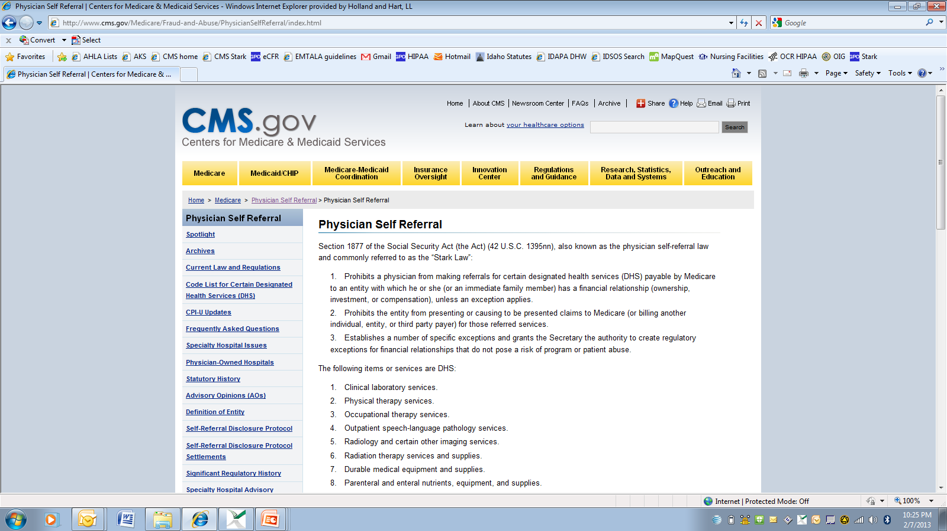
http://www.cms.gov/Medicare/Fraud-and-Abuse/PhysicianSelfReferral/index.html
Advisory opinions
FAQs
DHS by CPT code
Seff-Referral Disclosure Protocol
Recent
settlements

Slide 44

Civil Monetary Penalties Law
(42 USC 1320a-7a)

Slide 45
Civil Monetary Penalties Law
Prohibits certain specified conduct:
  Submitting false or fraudulent claims or misrepresenting facts relevant to services.
  Offering, soliciting, giving or receiving remuneration to induce referrals (i.e., kickbacks).
  Offering inducements to program beneficiaries.
  Offering inducements to physicians to limit services.
  Submitting claims for services ordered by, or contracting with, an excluded entity.
  Failing to report and repay an overpayment.
  Failing to grant govt timely access.
(42 USC 1320a-7a; 42 CFR 1003.102)

Slide 46
Civil Monetary Penalties Law
Penalties vary based on conduct, but generally range from:
  $2,000 to $50,000 fines
  3x amount claimed
  Denial of payment
  Repayment of amounts improperly paid
  Exclusion from government programs
CMPL violations may also violate:
  False Claims Act
  Anti-Kickback Statute
  Stark

Slide 47
Inducements to Govt Program Patients
Cannot offer or transfer remuneration to Medicare or state program beneficiaries if you know or should know that the remuneration is likely to influence the beneficiaries to order or receive items or services payable by federal or state programs from a particular provider.
Penalty:
  $10,000 for each item or service.
  3x amount claimed.
  Repayment of amounts paid.
  Exclusion from Medicare and Medicaid.
(42 USC 1320a-7a(a)(5); 42 CFR 1003.102).
Also a likely violation of the Anti-Kickback Statute

Slide 48
Inducements to Govt Program Patients
“Remuneration” = anything of value, including but not limited to:
  Waiver of co-pays and deductibles unless satisfy certain conditions, and
  Items or services for free or less than fair market value unless satisfy certain conditions.
(42 USC 1320a-7a(i); 42 CFR 1003.101; OIG Bulletin, Gifts to Beneficiaries)

Slide 49
Inducements to Govt Program Patients
“Remuneration” does not include:
  Waivers or co-pays based on financial need or after failed collection efforts if certain conditions met.
  Items or services if financial need and certain conditions met.
  Incentives to promote delivery of preventative care.
  Payments meeting Anti-Kickback Statute safe harbor.
  Retailer coupons, rebates or rewards offered to public.
  Any other remuneration that promotes access to care and poses a low risk of harm to patients and federal health care programs.
  Certain other situations.
(42 USC 1320a-7a(i); 42 CFR 1003.101)

Slide 50
Inducements to Govt Program Patients
OIG has approved the following in opinions or comments:
  Free or discounted item or service of low value, i.e.,
    Each item or service is less than $10, and
    Aggregate is less than $50 per patient per year.
  (OIG Bulletin, Offering Gifts and Inducements to Beneficiaries (8/02); 66 FR 24410-11)
  Free screenings not conditioned on or tied to additional services from any provider. (Adv. Op. 09-11)
  Free transportation programs where transportation is reasonable and local, open to patients regardless of payor, and other transportation options are limited. (Adv. Op. 11-02; OIG Bulletin, Offering Gifts and Inducements to Beneficiaries (8/02)).

Slide 51
Payment to Limit Services
Hospital or CAH cannot knowingly make a payment, directly or indirectly, to a physician as an inducement to reduce or limit services provided to Medicare or Medicaid beneficiaries who are under the direct care of the physician.
  Includes “gainsharing” programs.
Penalties:
  $2000 for each individual with respect to whom payment made.
  Any other penalty allowed by law.
(42 USC 1320a-7a(b)(1); 42 CFR 1003.102)

Slide 52
Payment to Limit Services
OIG has periodically approved gainsharing in advisory opinions if certain safeguards included, e.g.,
  Proposed plan does not adversely affect patient care.
  Quality evaluated by third party.
  Low risk that incentive will lead physicians to provide medically inappropriate care.
  Payments limited in duration and amount.
(See, e.g., Adv. Op. 12-22)
OIG advisory opinions do not apply to Stark.
CMS/OIG have issued interim rule waiving CMPL and Stark for ACOs.

Slide 53
Excluded Entities
Cannot submit claim for item or service ordered or furnished by an excluded person.
Cannot hire or contract with an excluded entity or arrange for excluded entity to provide items or services payable by federal programs.
Penalties
  $10,000 per item or service.
  3x amount claimed.
  Repayment of amounts paid.
  Exclusion from Medicare and Medicaid
(42 USC 1320a-7a(a)(8); 42 CFR 1003.102; OIG Bulletin, Effect of Exclusion)

Slide 54
Excluded Entities
Medicare, Medicaid, or other federal program will not pay claim if person “knew or should have known” of exclusion.
  Exception for certain emergency services.
(42 CFR 1001.1901(b) and .1003.102(a))
Knowledge =
  Knew or should have known of exclusion.
  Notified by HHS of exclusion, e.g., in response to claim.
  Listed on the List of Excluded Individuals or Entities (“LEIE”).

Slide 55
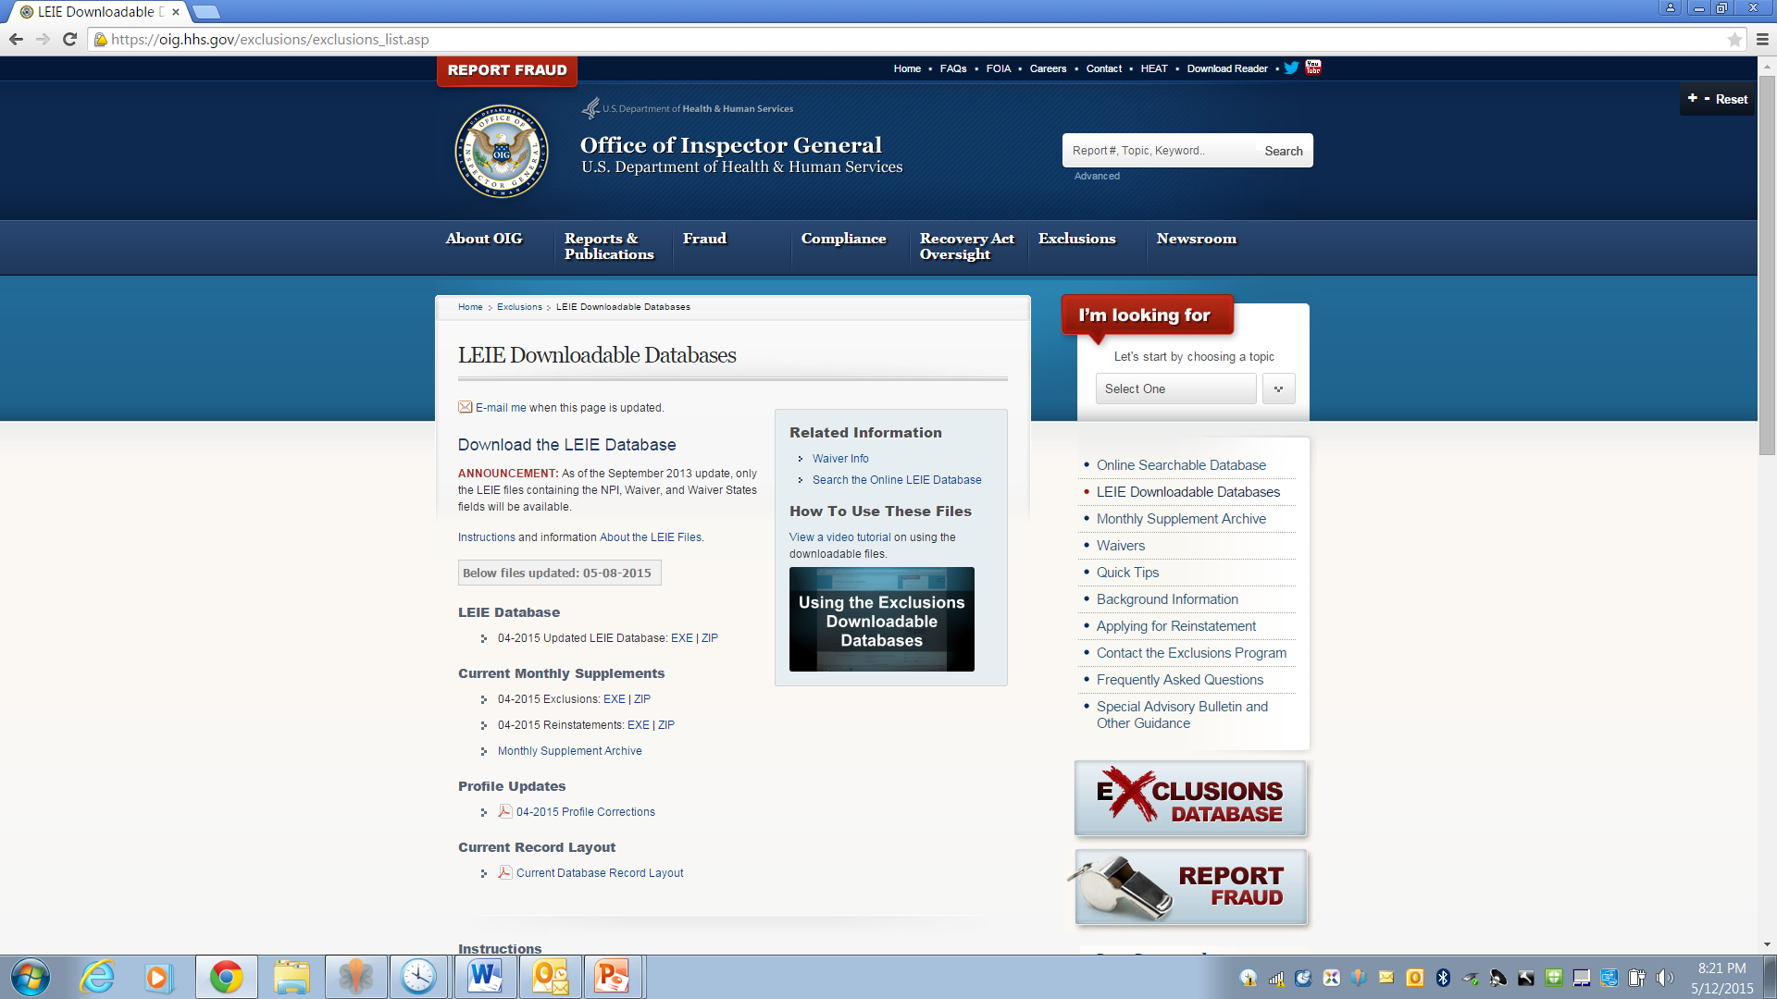

Slide 56
List of Excluded Individuals and Entities (“LEIE”)
OIG maintains LEIE and updates monthly: https://oig.hhs.gov/exclusions/exclusions_list.asp
Check LEIE before hiring or contracting with entities.
  Employees, contractors, vendors, medical staff, etc.
Check LEIE periodically to determine status.
  Employees, providers, vendors, medical staff members, ordering providers, others?
Condition contracts and medical staff membership on non-exclusion.
Respond promptly if receive notice of excluded entity.

Slide 57
Advisory Opinions
OIG may issue advisory opinions.
  Listed on OIG fraud and abuse website, www.oig.hhs.gov/fraud.
Not binding on anyone other than participants to the opinion.
But you are probably fairly safe if you act consistently with favorable advisory opinion.

Slide 58

Repay Overpayments (18 USC 1347)

Slide 59
Repayment Law
If provider has received an “overpayment”, provider must:
  Return the overpayment to federal agency, state, intermediary, or carrier, and
  Notify the entity of the reason for the overpayment.
Must report and repay within the later of:
  60 days after overpayment is identified, or
  date corresponding cost report is due.
(42 USC 1320a-7k(d))
No “finders keepers”

Slide 60
Repayment Law
“Knowing” failure to report and repay by deadline =
  False Claims Act violation
    $5,500 to $11,000 per violation
    3x damages
    Qui tam lawsuit
    (31 USC 3729)
  Civil Monetary Penalty Law violation
    $10,000 penalty
    3x damages
    Exclusion from Medicare or Medicaid
    (42 USC 1320a-7a(a)(10))

Slide 61
Repayment Law
“Overpayment” = funds a person receives or retains to which the person, after applicable reconciliation, is not entitled, e.g.,
  Payments for non-covered services
  Payments in excess of the allowable amount
  Errors and non-reimbursable expenses in cost reports
  Duplicate payments
  Receipt of Medicare payment when another payor is primary
  Payments received in violation of:
    Stark
    Anti-Kickback Statute
    Exclusion Statute

Slide 62
Repayment Law
Condition of payment from govt program
Condition of participation in govt program other regulation
Requires repayment, e.g.,
  Billing or claim requirements
  Anti-Kickback Statute
  Stark
  Civil Monetary Penalties re excluded individuals
Does not necessarily require repayment, e.g.,
  Conditions of Participation
  Conditions of Coverage
  Licensure requirements
  HIPAA
  EMTALA
  OSHA

Slide 63
Proposed Repayment Rule
To report and repay overpayments, use existing voluntary refund process (“self-reported overpayment refund process”) for contractor (Noridian).
  Use form that contractors maintain on their website.
  Among other things, must disclose:
    how error was discovered
    corrective action plan to avoid repeat
    reason for refund
    total amount of refund
    if statistical sample used, method for calculation.
  Include refund.
(77 FR 9179 (2/16/12))

Slide 64
Proposed Repayment Rule
Must report and return payment within later of:
  60 days after overpayment identified, or
  if overpayment related to issue in cost report, date corresponding cost report is due.
Overpayment “identified” if person:
  Has actual knowledge of existence of overpayment, or
  Acts in reckless disregard or deliberate ignorance.
  Not necessarily amount of repayment.
If have notice of potential overpayment, must make “reasonable inquiry” with “all deliberate speed” to determine whether overpayment exists.

Slide 65
Proposed Repayment Rule
Repayment per Repayment Rule does not resolve violations or penalties under other laws, e.g.,
  Anti-Kickback Statute, Civil Monetary Penalties Law, or False Claims Act, which are resolved by OIG or DOJ.
  Stark, which is resolved by CMS.
If Medicare contractor believes repayment involves violation of federal law, contractor may report repayment to the OIG, CMS, or other federal agency.
  Be careful how and what you disclose.
May want to consider other disclosure protocols.
  OIG Self-Disclosure Protocol
  Stark Self-Referral Disclosure Protocol

Slide 66
Idaho Medicaid: Duty to Repay
Provider must repay overpayments or claims previously found to have been obtained contrary to statute, rule regulation or provider agreement.
Penalties
  Exclusion from state health programs,
  e.g., Medicaid
  Civil penalty of up to $1000 per violation
  Referral to Medicaid fraud unit
(IC 56-209h(6)(h))
Provider agreement requires providers to immediately repay overpayments.

Slide 67
Idaho Medicaid: Duty to Repay
Medicaid ostensibly requires immediate repayment.
  Notice requires response within 15 days.
  May have up to 60 days interest free.
May enter repayment agreement, which is typically no longer than 12 months.

Slide 68
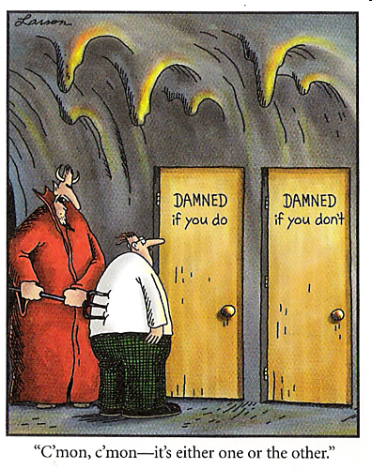

Slide 69
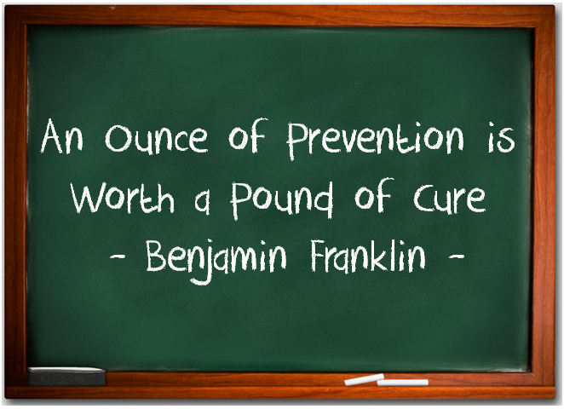
Better to comply in the first place!

Slide 70

Compliance Plans

Slide 71
Why have a compliance plan?
ACA will require providers to have compliance plan as condition to enrollment in Medicare, Medicaid, SCHIP. (ACA 6401)
  HHS to develop “core elements” of required compliance plans.
  HHS has not issued implementing regulations for physicians yet.
  Regulations issued for other providers suggests that HHS will track elements from earlier Compliance Program Guidance.

Slide 72
Why have a compliance plan?
Even if not mandated, compliance plan is still a good idea.
  May facilitate compliance and avoid repayments and penalties.
  May help avoid fraud charges.
  May mitigate penalties.
  May improve performance.
    facilitates prompt claims submissions
    identifies undercoding as well as upcoding
    reduces claim denials
    improves medical record documentation
    may identify and prevent patient care problems
Compliance plan = preventative medicine

Slide 73
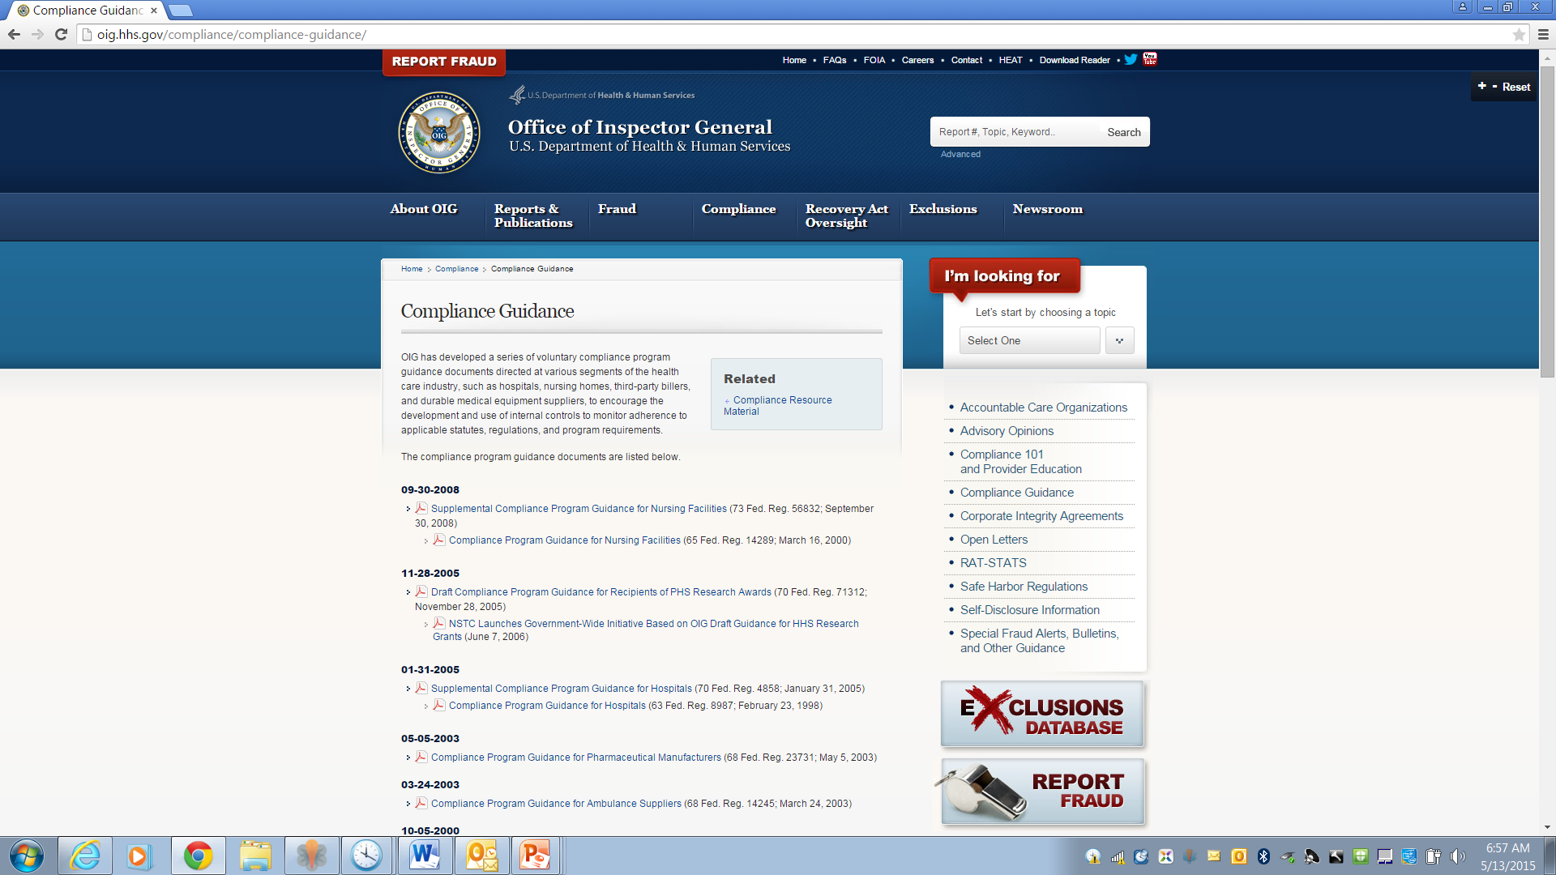

Slide 74
OIG Compliance Program Guidance
Not mandatory.
Not a compliance plan itself.
Provides a guide or outline for a compliance plan.
Feds will give some deference if plan addresses the elements and standards in the OIG guidance.
  7 elements are based on Federal Sentencing Guidelines.
Unlike other similar programs, OIG is very flexible and does not expect small practices to formally implement all 7 elements.

Slide 75
OIG Compliance Guidance:
Elements
Internal monitoring and auditing.
Written standards, policies and procedures.
Compliance officer or contacts.
Education and training.
Investigation of alleged violations and appropriate disclosures to government agencies.
Open lines of communication, e.g., open discussions at staff meetings or bulletin board notices.
Enforcement of disciplinary standards.
Implementation depends on size and resources of group.

Slide 76

Action Items

Slide 77
Action Items
Identify remuneration to referral sources (e.g., providers, facilities, vendors, govt program patients).
  Contracts (employment, independent contractors, etc.).
  Group compensation structures.
  Leases (space, equipment, etc.).
  Subsidies or loans.
  Joint ventures or partnerships.
  Free or discounted items or services (e.g., use of space, equipment, personnel or resources; professional courtesies; gifts; etc.).
  Marketing programs.
  Financial policies.

Slide 78
Action Items
Review relationships for compliance with statute or exception, e.g.,
  No intent to induce referrals for government program business.
  Written contract that is current and signed by parties.
  Compliance with terms of contract.
    Parties providing required services.
    Documentation confirming that services provided.
  Fair market value.
  Compensation not based on volume or value of referrals.
  Arrangement is commercially reasonable and serves legitimate business purpose.

Slide 79
Action Items
Implement method to track and monitor relationships with referral sources for compliance.
  Central repository for contracts or deals.
  Method to track contract termination dates.
  Process for confirming compliance before payment.
  Require review and approval by compliance officer, attorney or other qualified individual.
    Contracts.
    Joint transactions with referral sources.
    Benefits or perks to referral sources.
    Marketing or advertising.

Slide 80
Action Items
Ensure your compliance policies address fraud and abuse laws.
Train key personnel regarding compliance.
  Administration.
  Compliance officers and committees.
  Human resources.
  Physician relations and medical staff officers.
  Marketing / public relations.
  Governing board members.
  Purchasing.
  Accounts payable.
Document training.

Slide 81
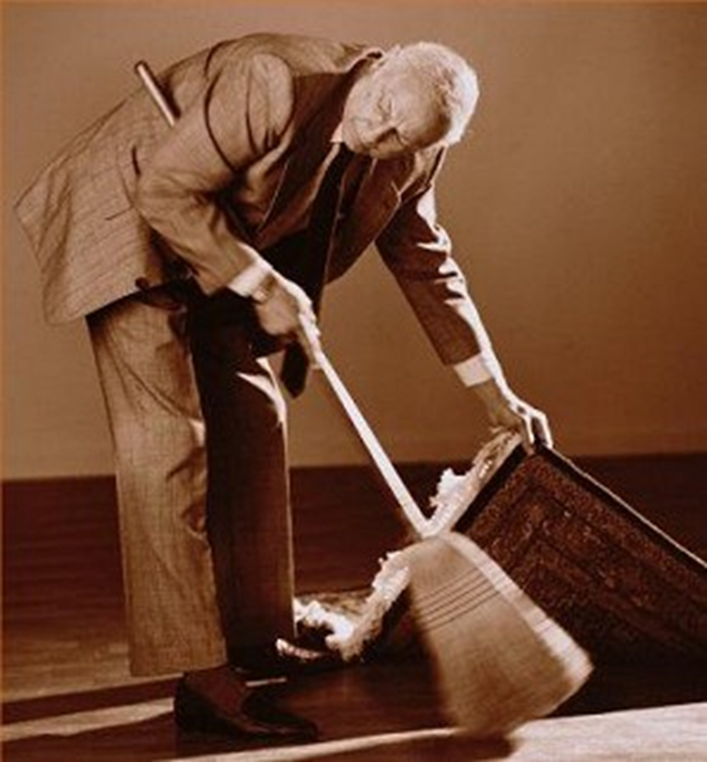
If you think you have a problem
Don’t do this!

Slide 82
If you think you have a problem
Suspend payments or claims until resolved.
Investigate problem per compliance plan.
  Consider involving attorney to maintain privilege.
Implement appropriate corrective action.
  But remember that prospective compliance may not be enough.
If repayment is due:
  Report and repayment per applicable law.
  Self-disclosure program.
    To OIG, if there was knowing violation of False Claims Act, Anti-Kickback Statute or Civil Monetary Penalties Law.
    To CMS, if there was violation of Stark.

Slide 83

Additional Resources

Slide 84
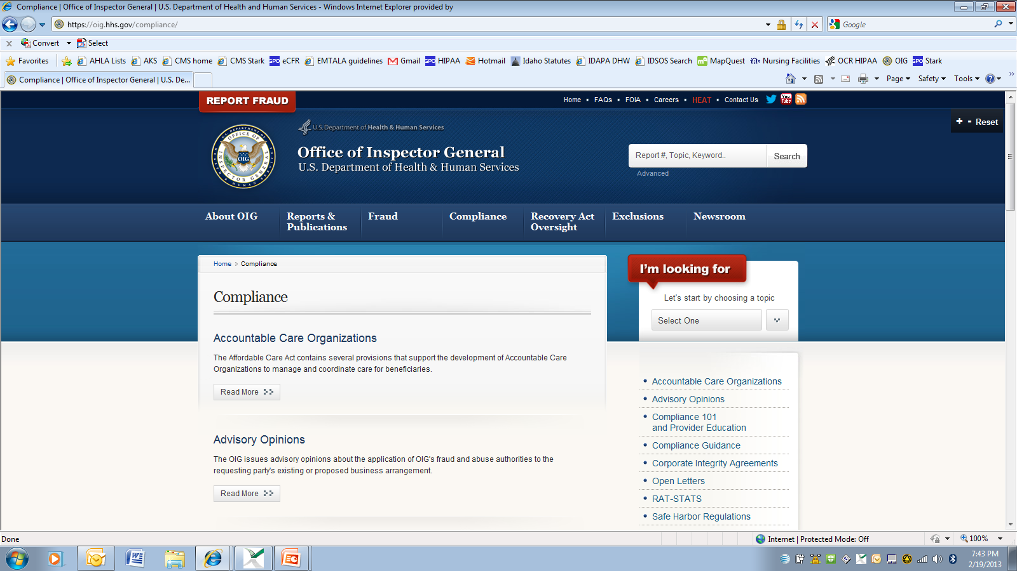
https://oig.hhs.gov/compliance/

Slide 85
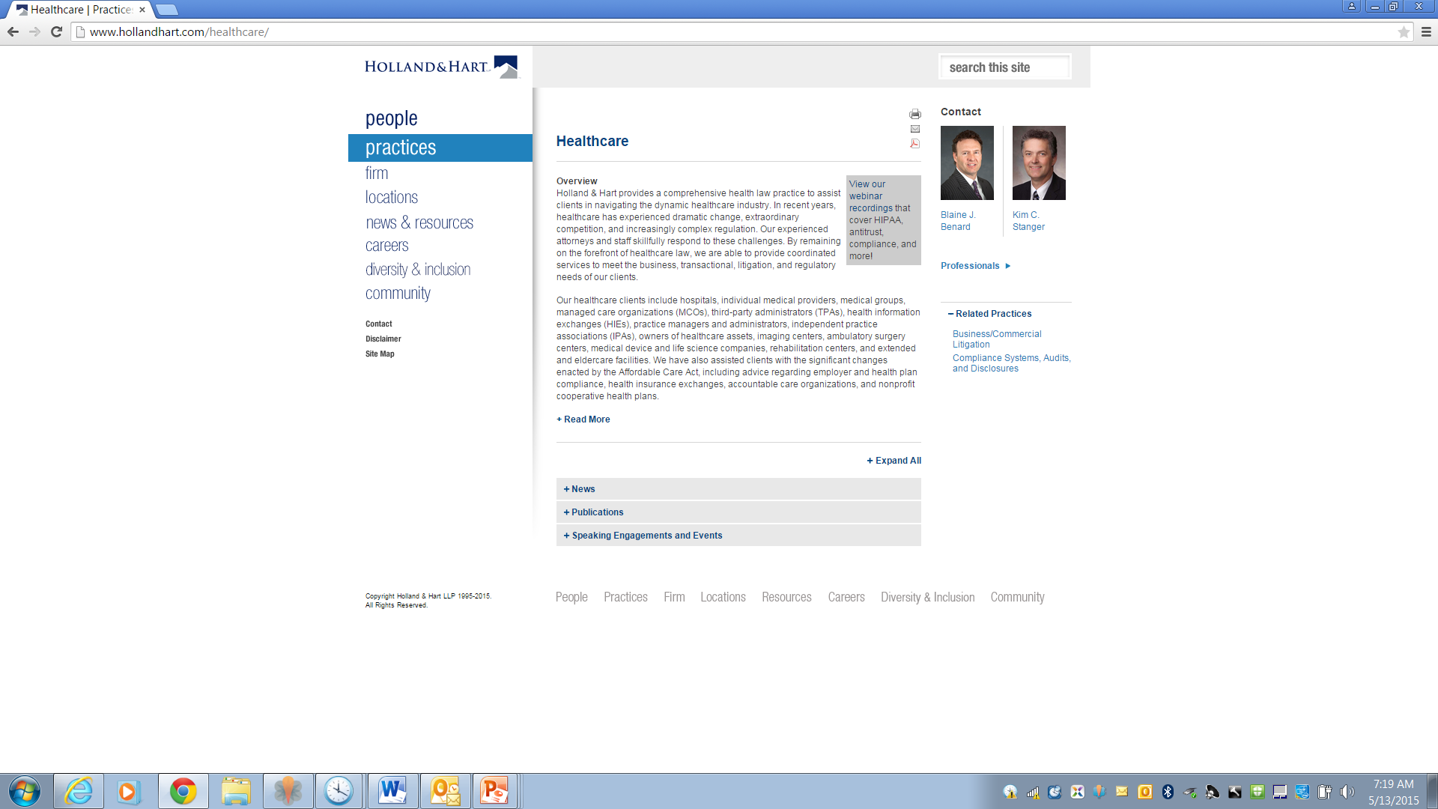
Webinars
Publications

Slide 86

Questions?
Kim C. Stanger
(208) 383-3913
(208) 409-7907 (cell)
kcstanger@hollandhart.com
Melissa Starry
(208) 383-3984
(208) 598-4001
mmstarry@hollandhart.com

