Slide 1
Emergency Medical Treatment and Active Labor Act (“EMTALA”)
Kim C. Stanger
Compliance Bootcamp
(5-15)

Slide 2
This presentation is similar to any other legal education materials designed to provide general information on pertinent legal topics. The statements made as part of the presentation are provided for educational purposes only. They do not constitute legal advice nor do they necessarily reflect the views of Holland & Hart LLP or any of its attorneys other than the speaker. This presentation is not intended to create an attorney-client relationship between you and Holland & Hart LLP. If you have specific questions as to the application of law to your activities, you should seek the advice of your legal counsel.

Slide 3
EMTALA
You should know EMTALA if:
You provide services at or for a hospital.
Your providers participate in call coverage or provide emergency services at a hospital.
You might go to the emergency department.

Slide 4
EMTALA Requirements
Hospital with a dedicated emergency dept must provide:
Emergency medical screening exam,
Stabilizing treatment for emergency conditions, and/or
Appropriate transfer of unstabilized person.
Participating hospital with specialized capabilities must accept transfer of unstabilized person.
Cannot delay exam or treatment to inquire about payment.
Must post required signage.
Must maintain required documentation.
On-call list.
ED log of those who come to hospital.
(42 USC 1395dd; 42 CFR 489.20(r) and 489.24)

Slide 5
EMTALA Penalties
Civil penalties
Physicians: $50,000 per violation.
Hospitals:
Less than 100 beds: $25,000 per violation
100+ beds: $50,000 per violation
Hospitals may be sued for damages.
Individuals who suffer personal harm.
Medical facilities that suffer financial loss.
Termination of Medicare provider agreement and exclusion from Medicare and Medicaid.
(42 USC 1395dd(d); 42 CFR 1003.103(e))

Slide 6
EMTALA Triggers

Slide 7
EMTALA Triggers
For hospitals with a dedicated emergency dept (“DED”), EMTALA is triggered if:
Person “comes to the hospital”,
Request is made for emergency care, and
Person is not already a patient at the hospital.
For hospitals without a DED (e.g., specialty hospital), EMTALA is triggered if:
Hospital participates in Medicare,
Hospital has specialized capabilities, and
Hospital receives request for transfer from another facility.
(42 CFR 489.24)

Slide 8
Person Comes to the Hospital
“Comes to the hospital” =
Main campus of hospital, including parking lot, sidewalk, and driveway.
Area within 250 yards of hospital that is owned by the hospital, e.g., provider-based department.
Off-campus facility with a dedicated emergency dept (“DED”).
In hospital-owned ambulance.
(42 CFR 489.249(b); Interpretive Interpretive Guidelines 489.24(a))
Cannot divert inbound ambulance unless you are on diversionary status. (Arrington v. Wong (9th Cir. 2001))
May discuss best interests of patient.

Slide 9
Request for Emergency Care
EMTALA applies if a request is made for emergency care or reasonably prudent person would believe person requires emergency care.
EMTALA does not apply to requests for clearly non-emergent care, e.g.,
Preventative care (e.g., immunization, flu shots, community outreach, etc.)
Requests to perform non-emergency test (e.g., blood pressure or x-ray).
Gather evidence (e.g., BAC test, sexual assault, etc.)
Prescheduled appointment by physician.
*Document non-emergent request.
(Interpretive Interpretive Guidelines 489.24(c))

Slide 10
Person Is Not Already A Patient
EMTALA does not apply to “patients” of hospital.
Inpatients: EMTALA ends once the person is admitted as an inpatient in good faith, i.e., admitted for bed occupancy with expectation that person will remain overnight.
Outpatients: EMTALA does not apply if person has begun receiving outpatient services other than emergency care.
EMTALA does not apply even if emergency arises after person’s admission or after outpatient services begin.
(42 CFR 489.24(a)-(b), (d)(2); Interpretive Guidelines 489.24(a), (d))

Slide 11
Medical Screening Exam
EMTALA Ends;
May transfer or discharge the patient
No Emergency Medical Condition
Medical Screening Exam
Stabilizing Treatment
Yes Emergency Medical Condition
Appropriate Transfer

Slide 12
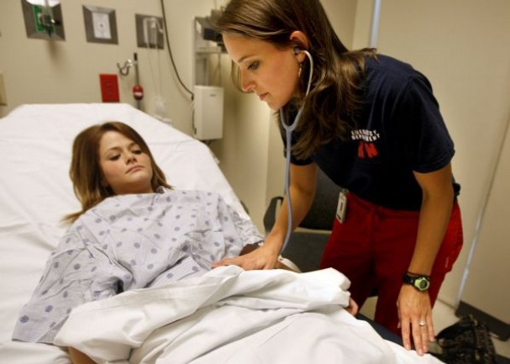
Medical Screening Exam

Slide 13
Medical Screening Exam
Appropriate medical screening exam =
Performed by qualified medical personnel (“QMP”).
Identified in documents approved by governing body.
Competent to perform exam.
Privileged to perform exam.
Applied in non-discriminatory manner.
Does not differ based on payment status, condition, race, national origin, disability, etc.
Sufficient to allow QMP to determine, with reasonable clinical confidence, whether emergency condition exists.
Depends on presenting signs and symptoms, and hospital’s capabilities, including on-call physicians.
(Interpretive Guidelines 489.24(a), (e))

Slide 14
Medical Screening Exam
Screening exam is ongoing process, not isolated event.
Begins with triage but goes beyond triage.
Continues until stabilized, admitted or transferred.
Should normally include—
Vital signs.
History.
Documented physical exam of involved area or system.
If needed, ancillary tests and specialists available through hospital, e.g., lab tests, diagnostic tests and procedures, CT scans or other imaging services, etc.
Continued monitoring.
(Interpretive Guidelines 489.24(a))

Slide 15
Medical Screening Exam
If it’s not in
the chart,
it didn’t happen.

Slide 16
Emergency Medical Condition
A medical condition manifesting itself by acute symptoms of sufficient severity (including severe pain, psychiatric disturbances, and/or substance abuse) such that the absence of immediate medical attention could reasonably be expected to result in
Placing the individual’s health in serious jeopardy;
Serious impairment to bodily functions; or
Serious dysfunction of any bodily organ or part.
With respect to a pregnant woman who is having contractions—
That there is inadequate time to effect a safe transfer to another hospital before delivery; or
That transfer may pose a threat to the health or safety of the woman or the unborn child.
(42 CFR 489.24(b))

Slide 17
Medical Screening Exam
EMTALA Ends; May transfer or discharge patient
No Emergency Medical Condition
Medical Screening Exam
Stabilizing Treatment
Yes Emergency Medical Condition
Appropriate Transfer

Slide 18
Stabilizing Treatment

Slide 19
Stabilizing Treatment
If medical screening exam reveals an emergency medical condition, hospital must provide either:
Stabilizing treatment within its capabilities.
Such care necessary to assure, within reasonable medical probability, that no material deterioration of condition is likely to result from or occur during transfer from facility, or
For pregnant woman, delivery of child and placenta.
An appropriate transfer to another facility.
EMTALA ends once patient is stabilized or admitted.
(42 CFR 489.24(d))

Slide 20
Stable for Transfer
Under regulation, stabilized =
No material deterioration of condition is likely, within a reasonable medical probability, to result from transfer, or
For pregnant woman, delivery of child and placenta.
(42 CFR 489.24(b))
Under Interpretive Interpretive Guidelines, stabilized =
Emergency medical condition has resolved, even though underlying medical condition may persist.
For psychiatric conditions, person is protected and prevented from harming themselves or others.
(Interpretive Guidelines 489.24(d))

Slide 21
Stable for Discharge
Within reasonable clinical confidence, patient has reached a point where their continued care (including diagnostics or treatment) could be reasonably performed as an outpatient or later as an inpatient provided the patient is given a plan for appropriate follow-up care as part of discharge instructions.
For psychiatric conditions, that the patient is no longer a threat to themselves or others.
(Interpretive Guidelines 489.24(d))

Slide 22
Stable for Transfer or Discharge: Pregnancy
For pregnant woman in labor, “stabilized” = delivery of the child and the placenta.
If a woman is having contractions:
Hospital must deliver the baby and placenta, or
Hospital must perform appropriate transfer, including discharge back to home.
False labor must be certified by QMP after reasonable period of observation.
(42 CFR 489.24(d))

Slide 23
Stable for Transfer or Discharge
DOCUMENT, DOCUMENT, DOCUMENT!

Slide 24
Stabilizing Treatment
EMTALA Ends, but may have malpractice duties
Patient is stabilized
or
admitted
Stabilizing Treatment
Continue Stabilizing Treatment
Patient is not stabilized
Appropriate Transfer

Slide 25
Appropriate Transfers

Slide 26
Appropriate Transfer
If patient is not stabilized, hospital may not transfer or discharge patient unless:
Either one of the following—
Patient or representative requests transfer, or
Physician certifies that benefits outweigh risks; and
Transfer is “appropriate” under regulations.
Transfer = Movement outside hospital at direction of hospital personnel, including discharge.
Not if person leaves the hospital without permission.
Not movement within or between the same hospital.
(42 CFR 489.24(b), (d)(e); Interpretive Guidelines 489.24(a))

Slide 27
Appropriate Transfer
Transfers of unstable patients must be “appropriate”, i.e.,
Transferring hospital provides treatment within its capability to minimize risk of harm to patient.
Transferring hospital contacts receiving facility and facility agrees to accept the transfer.
Identify person with authority to accept for receiving facility.
Transferring hospital sends:
Relevant records available at the time.
Name on-call physician who failed to respond, if any.
Additional records as soon as practicable.
Transfer effected through qualified personnel with proper equipment, including life support measures.
(42 CFR 489.24(e)(2))

Slide 28
Patients Who Refuse Exam, Treatment, or Transfer

Slide 29
Patients Who Refuse Exam, Treatment or Transfer
Hospital must—
Offer exam, treatment or transfer.
Document the exam, treatment or transfer that was refused.
Document that risks and benefits were explained to patient.
Document basis for refusal of transfer.
Take reasonable steps to secure written informed refusal.
If patient refuses to sign, document refusal.
(42 CFR 489.24(d)(3), (5))

Slide 30
Prompt Examination or Treatment

Slide 31
Do Not Delay or Discourage Exam or Treatment
Cannot delay exam or treatment to inquire about payment.
Cannot seek preauthorization from insurer until after you have conducted exam and initiated stabilizing treatment.
(42 CFR 489.24(d)(4); Interpretive Guidelines 489.24(a), (d)(4))
Do not suggest to patient that:
They should leave.
They could obtain services elsewhere at less cost.
Insurance may not cover treatment.
(Interpretive Guidelines 489.24(a), (d)(4))

Slide 32
Do Not Delay or Discourage Exam or Treatment
So long as it does not delay or discourage exam or treatment, hospital may
Follow reasonable registration process (e.g., obtain demographics, obtain insurance information or card, identify emergency contact, etc.).
Not condition treatment on payment.
Contact primary physician or health plan to obtain history or identify needs.
Not seek preauthorization.
Have knowledgeable person answer questions about payment.
(Interpretive Guidelines 489.24(a))

Slide 33
Avoiding Penalties

Slide 34
Avoiding Penalties
Do what is in the best interest of the patient.
Document, document, document!
Appropriate medical screening exam, including:
Performed by QMP.
Addressed presenting symptoms.
Ongoing monitoring.
Whether patient had emergency medical condition.
Whether patient was stabilized.
Patient received appropriate transfer, including physician certification of risks and benefits.
Patient left AMA.

Slide 35
Avoiding Penalties
Maintain written EMTALA policies, forms and signs.
Train and re-train staff regarding EMTALA compliance.
Document the training.
Maintain on-call list.
Ensure physicians respond to call.
Ensure QMPs are identified and qualified.
Identified in document approved by board.
Privileged to provide screening exams.
Maintain and periodically review ED log.
Update as appropriate.

Slide 36
Avoiding Penalties
Beware transfer by private car.
Document that we offered alternative transport.
Document circumstances of transfer.
Beware inbound ambulances.
Generally cannot turn away unless on divert.
May discuss treatment alternatives, but document.
Beware requests for transfer to your facility.
Require requests to come to authorized persons.
Confirm your own capacity.
Confirm specialized capabilities.

Slide 37
Avoiding Penalties
Immediately respond to suspected violations.
Gather and confirm facts, including documents and witness statements.
Supplement record as appropriate.
Impose sanctions if appropriate.
Provide additional training.
No duty to self-report your own violations.
May want to self-report if another hospital will report.
Must report:
On-call physicians who failed to respond.
Receipt of improper transfer.

Slide 38
Avoiding Penalties
If government investigates:
Cooperate with investigation.
Gather and supplement with important facts.
Implement appropriate plan of correction.
Respond with your explanation of the facts.
If there was no EMTALA violation, explain why.
If there was EMTALA violation, explain why you should not be penalized, e.g.,
Appropriate policies in place.
Appropriate training.
Rogue employee.
Corrective action taken.

Slide 39
Additional Resources

Slide 40
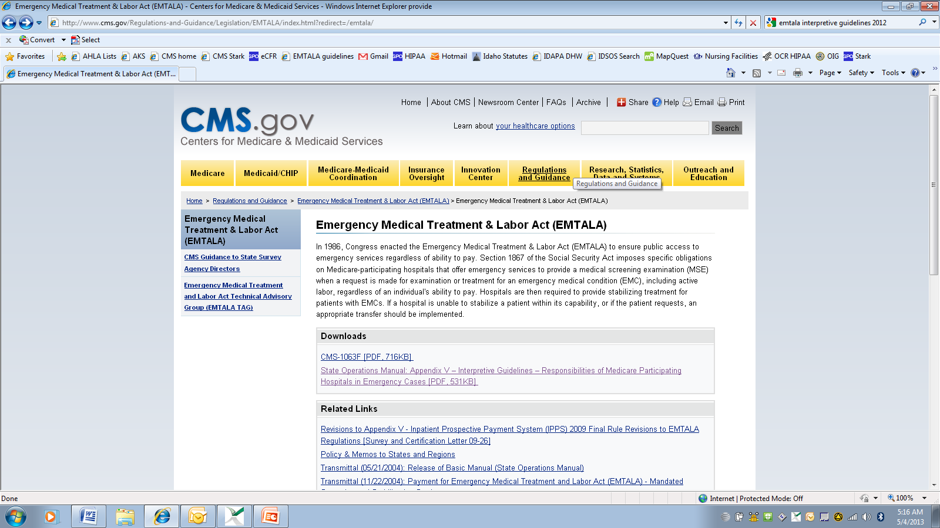
www.cms.gov/Regulations-and-Guidance/Legislation/EMTALA

Slide 41
Questions?
Kim C. Stanger
(208) 383-3913
(208) 409-7907 (cell)
kcstanger@hollandhart.com
Melissa Starry
(208) 383-3984
(208) 598-4001 (cell)
mmstarry@hollandhart.com

