Slide 1
Antitrust
Kim C. Stanger
Compliance Bootcamp
(5/15)

Slide 2
This presentation is similar to any other legal education materials designed to provide general information on pertinent legal topics. The statements made as part of the presentation are provided for educational purposes only. They do not constitute legal advice nor do they necessarily reflect the views of Holland & Hart LLP or any of its attorneys other than the speaker. This presentation is not intended to create an attorney-client relationship between you and Holland & Hart LLP. If you have specific questions as to the application of law to your activities, you should seek the advice of your legal counsel.

Slide 3
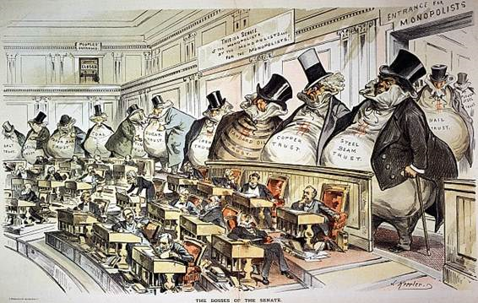
History
In late 1800’s, large corporate conglomerates (“trusts”) held monopolies, e.g.,
Standard Oil
Steel
Railroads
Copper
Sugar
Others
Their power allowed them to:
Control prices.
Restrict competition

Slide 4
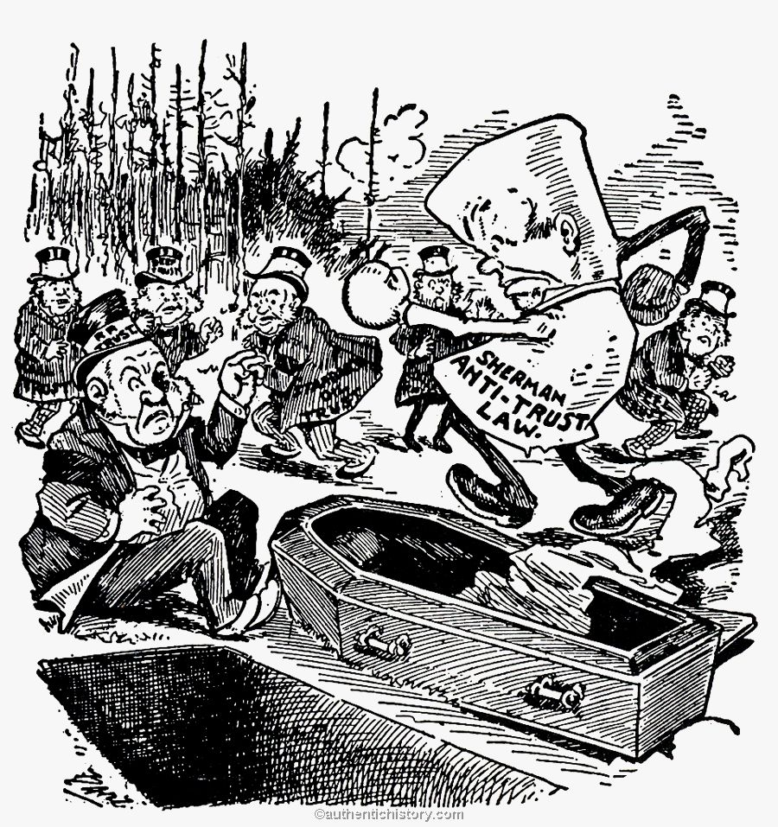
History
Federal antitrust laws
Sherman Act
Clayton Act
Federal Trade Comm’n Act
Robinson-Patman Act
Hart–Scott–Rodino Antitrust Improvements Act
State antitrust laws
IC 48-101 et seq.

Slide 5
Enforcement
Criminal penalties
Significant fines
Prison
Civil penalties
Action by state or federal government
Treble (3x) damages
Injunctive relief, e.g, divestiture, break up corporation, requirements for contracting, etc.
Attorneys fees
Private lawsuit
Treble damages
Injunctive relief
Attorneys fees

Slide 6
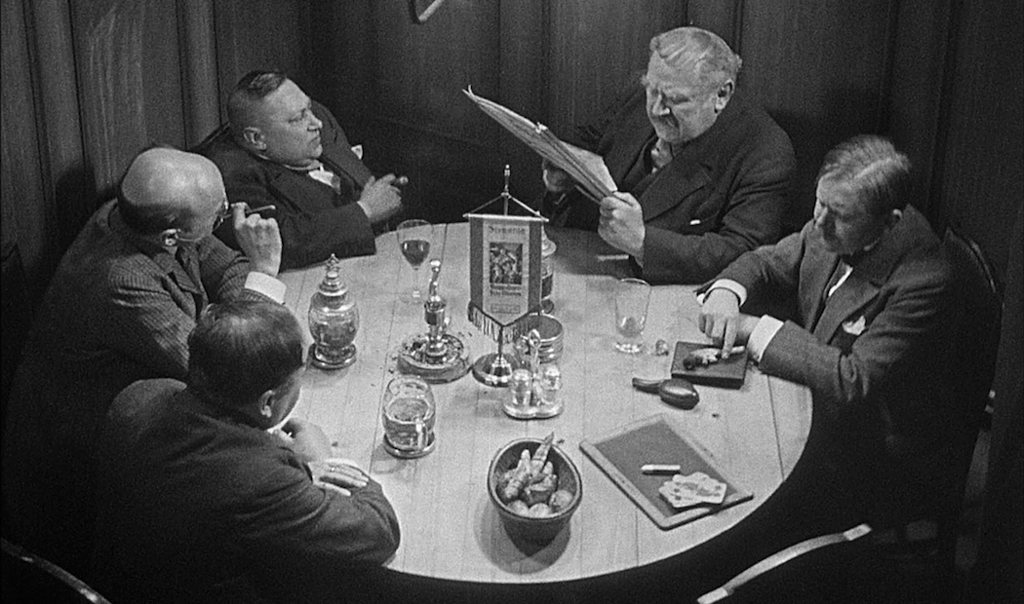
Sherman Act § 1
Competitor
Competitor

Slide 7
Sherman Act § 1
“Every contract, combination in the form of trust or otherwise, or conspiracy, in restraint of trade … is declared to be illegal. Every person who shall make any contract or engage in any combination or conspiracy hereby declared to be illegal shall be deemed guilty of a felony, and, on conviction thereof, shall be punished by fine not exceeding $100,000,000 if a corporation, or, if any other person, $1,000,000, or by imprisonment not exceeding 10 years, or by both said punishments, in the discretion of the court.”
(15 USC § 1)

Slide 8
Sherman Act § 1
Violation requires all of the following:
Contract, combination or conspiracy involving at least two independent parties.
Corporate officers and employees = same entity.
Members of same group practice = same entity.
An effect on interstate commerce.
Easy to satisfy.
Unreasonable restraint of trade.
Per se
Rule of reason
Quick look analysis
Standards for analyzing potential violations.

Slide 9
Sherman Act § 1
Rule of Reason = court balances pro-competitive effects against anti-competitive effects.
Pro-competitive effects of proposed action
Anti-competitive effects of proposed action
Anti-Competition
Pro-Competition
Parties present evidence of pro- and anti-competitive effects.

Slide 10
Sherman Act § 1
Per se = certain conduct is presumed to result in unreasonable restraint of trade and is per se unlawful.
Pro-competition
Pro-competitive effects
Market allocation
Boycotts
Price fixing
Anti-competition
Because conduct is deemed to unreasonably restrain trade, the plaintiff is not required to present evidence of effects.

Slide 11
Sherman Act § 1
Price fixing = competitors conspire or collude on prices.
May determine your own prices.
May not collude with others to agree on prices, output, etc.
Express agreement.
Implied agreement, e.g.,
Sharing price or price-related info.
Using same person to negotiate prices.
Applies to agreements re minimum or maximum prices.
DOJ/FTC Guidelines create safety zone under which some sharing of price info may be permitted or analyzed under rule of reason if entities are sufficiently integrated.

Slide 12
Sherman Act § 1
Boycotts = competitors agree not to deal with another entity.
May decide on your own not to do business with an entity.
May not agree with others that none of you will do business with the entity as a way to pressure other party.
Does not apply to labor strikes.

Slide 13
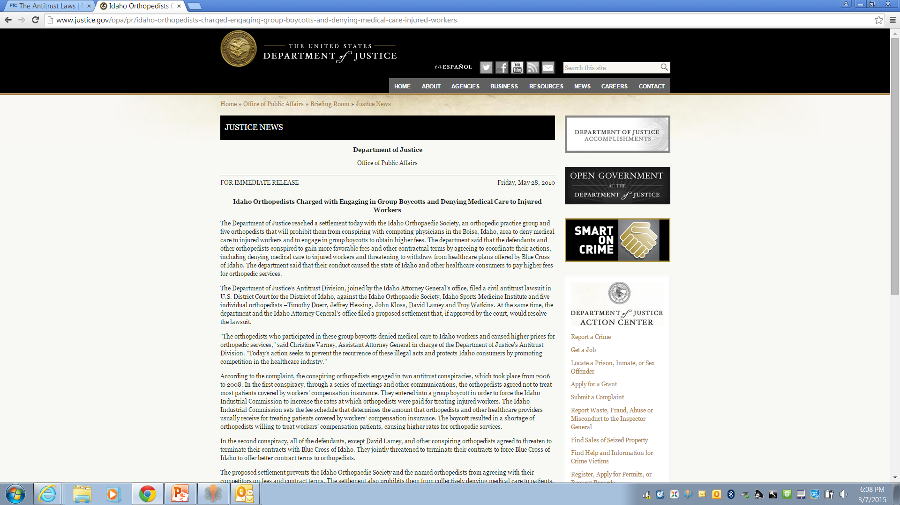

Slide 14
Sherman Act § 1
United States v. Idaho Orthpaedic Society (2010)
Complaint alleged that orthopedists:
Agreed not to treat patients covered by workers comp to force increased reimbursement.
Agreed to threaten termination of payer contracts unless they were given more favorable terms.
Settlement agreement includes, e.g.,
Prohibited from entering agreement concerning fees or other terms with payers or refusing to deal with payers.
Prohibited from communicating with competitors re acceptability of payer terms or response to same.
Certification of compliance for 10 years.

Slide 15
Sherman Act § 1
Market allocation = competitors agree to divide up market.
May decide on your own what items or services to offer, or where to do business.
May not agree with competitors to divide up markets or services.
Geographic territories
Products
Services

Slide 16
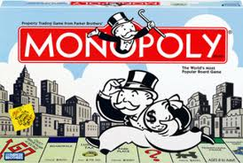
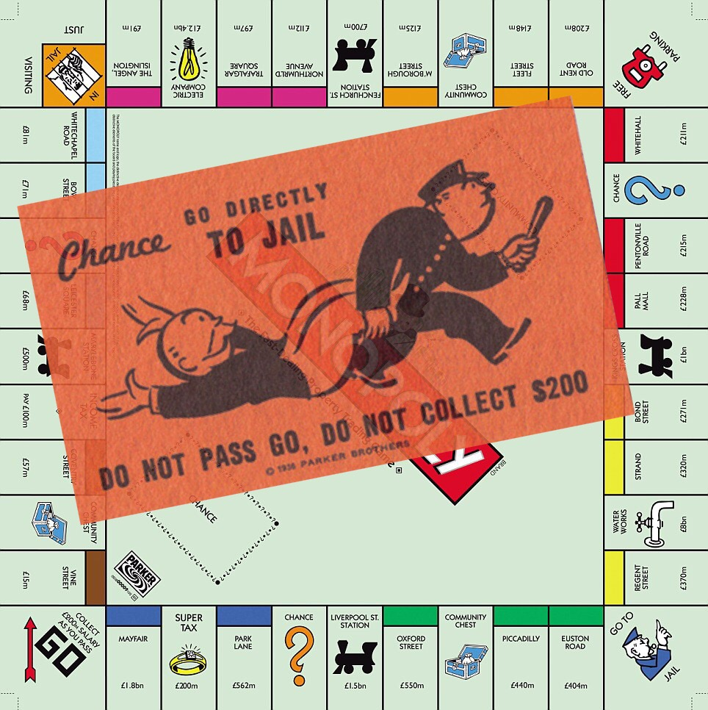
Sherman Act § 2

Slide 17
Sherman Act § 2
“Every person who shall monopolize, or attempt to monopolize, or combine or conspire with any other person or persons, to monopolize any part of the trade or commerce among the several States, or with foreign nations, shall be deemed guilty of a felony, and, on conviction thereof, shall be punished by fine not exceeding $100,000,000 if a corporation, or, if any other person, $1,000,000, or by imprisonment not exceeding 10 years, or by both said punishments, in the discretion of the court.”
(15 USC § 2)

Slide 18
Sherman Act § 2
Having monopoly power alone is not a violation.
E.g., having better product or greater skill
E.g., CON, govt franchise, or patent.
Violation requires both:
Monopoly power in a relevant market; and
Willful acquisition or maintenance of that monopoly power through use of coercive or inappropriate acts.
E.g., predatory pricing.

Slide 19
Clayton Act § 7

Slide 20
Clayton Act § 7
“No person … shall acquire the whole or any part of the assets of another person engaged also in commerce or in any activity affecting commerce, where … the effect of such acquisition may be substantially to lessen competition, or to tend to create a monopoly.”
(15 USC § 18)

Slide 21
Clayton Act § 7
To establish violation:
Determine relevant market.
Market = is the area of effective competition where buyers can turn for alternate sources of supply.
Test = whether monopolist in the proposed market could impose increase in prices.
Determine whether the merger will have anti-competitive effects in the relevant market.
Adverse effects on competition if there is merger.
Existing competition in the market.
Likelihood of other competitors entering market.
Efficiencies resulting from merger that could not be achieved through other means (“merger-specific”).
Whether one party would fail if there is no merger.

Slide 22
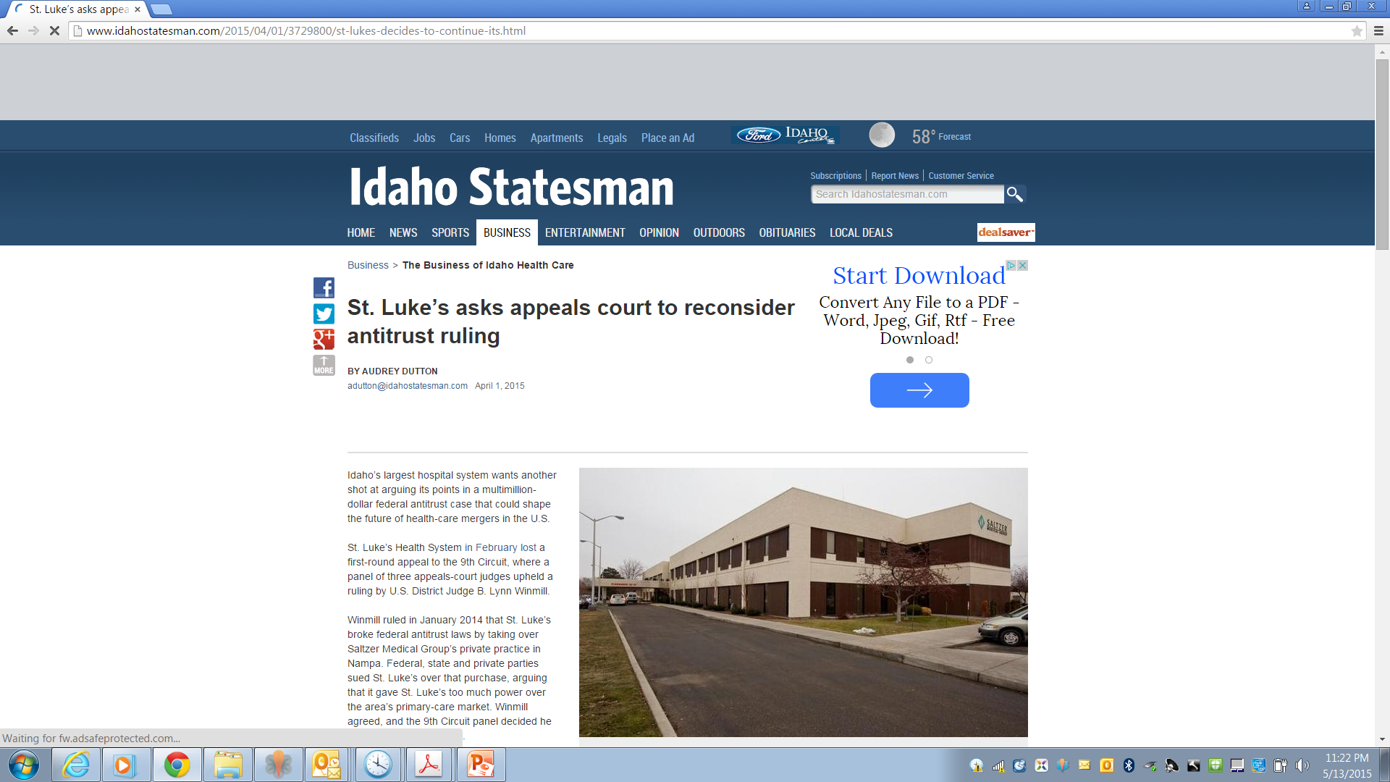

Slide 23
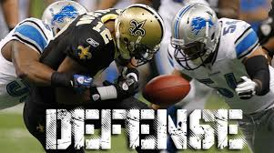
Antitrust Defenses

Slide 24
Antitrust Defenses
State action immunity
Applies to state actors.
Local Govt Antitrust Act
Applies to state and local government entities.
Health Care Quality Improvement Act (“HCQIA”)
Applies to credentialing decisions.
Noerr-Pennington Doctrine
Allows competitors to seek state action.

Slide 25
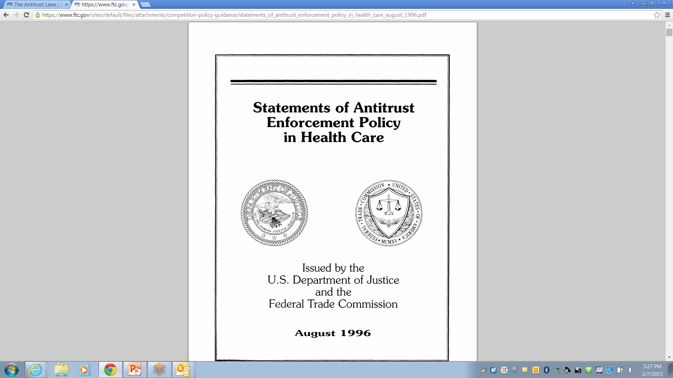
DOJ/FTC Statements of Antitrust Enforcement Policy in Health Care
Outlines DOJ/FTC enforcement policy for specific situations, e.g.
Mergers
Joint ventures
Networks
Sharing price info
Includes “safety zones” in which DOJ/FTC will not challenge action absent extraordinary circumstances.

Slide 26
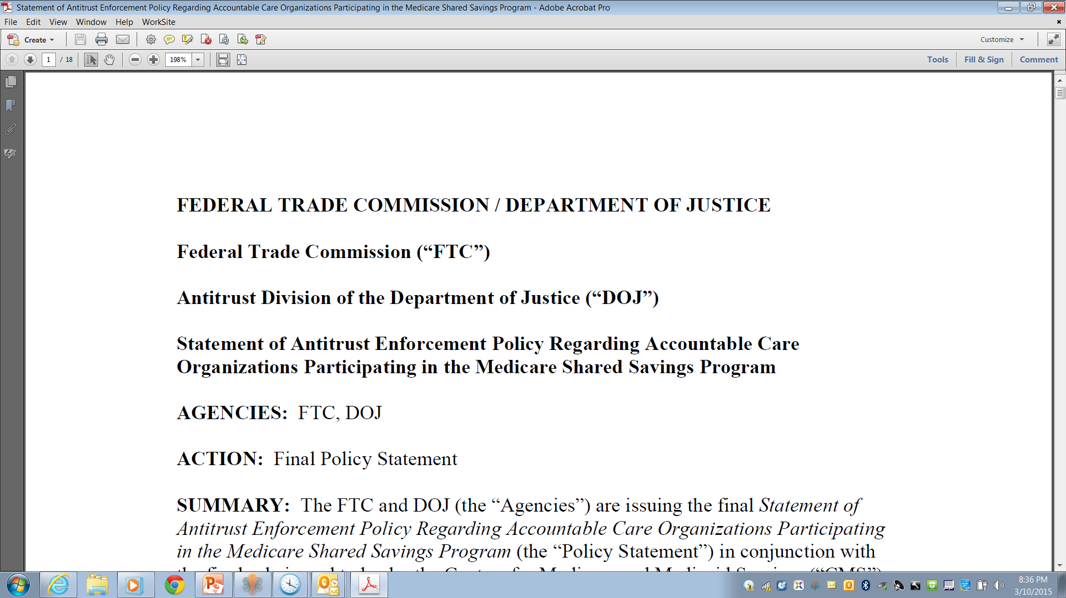
DOJ/FTC Statements of Antitrust Enforcement Policy Regarding Accountable Care Organizations

Slide 27
Questions?
Kim C. Stanger
(208) 383-3913
(208) 409-7907 (cell)
kcstanger@hollandhart.com
Melissa Starry
(208) 383-3984
(208) 598-4001
mmstarry@hollandhart.com

