Slide 1
Idaho Healthcare Compliance Bootcamp
Wage and Hour:
Are Your Pay Practices Compliant?
A. Dean Bennett
Holland & Hart LLP

Slide 2
Agenda
Wage and Hour Overview
Misclassification Crackdown
  Employee vs. Independent Contractor
  Exempt vs. Non-exempt
Upcoming Changes in Exemptions
Deductions From Salary
State Law Considerations
Liability for FLSA Violations

Slide 3

  (Employee Misclassification)

Slide 4

(Unpaid Overtime)

Slide 5

The Fair Labor Standards Act
Overview:
FLSA - Enacted in 1938
Federal law:
  Minimum wage
  Overtime pay
  Employment of minors
  Recordkeeping requirements
Enforced by the U.S. Department of Labor
Wage & Hour Division (WHD)
Notes:
Impacts an estimated 135 million workers

Slide 6
Covered Employers Under the FLSA
Private sector employers with $500,000 or more in revenue, or 2 or more employees engaged in interstate commerce
Hospitals and other health care institutions
Public sector employers
Schools
Most non-profits
Trade associations

Slide 7
Misclassifying as Independent Contractors
DOL crackdown on employers who misclassify workers as independent contractors who are employees under the law.
Notes:
U.S. DOL reports that studies suggest that 10 to 30 percent of employers may misclassify their employees as independent contractors
Sept. 15, 2014 – DOL announced that it awarded over $10 million to 19 states to enforce misclassification of independent contractors for unemployment insurance purposes.
Misclassifications - Employee vs. Independent Contractors
In order for the FLSA’s minimum wage and overtime pay provisions to apply, an employment relationship must exist between the “employer” and the worker (the worker must be an “employee”).
The FLSA’s definition of “employ” includes “to suffer or permit to work.”

Slide 8

Effect of Misclassification on Workers
Denied access to legal protections and benefits, such as:
  Minimum wage and overtime pay
  Workers’ compensation
  Family and medical leave
Notes:
Workers misclassified as independent contractors are wrongfully denied access to important benefits and protections, such as:
Minimum wage and overtime pay
Workers’ compensation
Family and medical leave
Misclassified employees may still be eligible for unemployment insurance, but misclassification complicates their ability to collect these benefits.

Slide 9
Tests for Independent Contractor Status – Federal & State
  DOL Economic Realities Test: is worker truly in business for him/herself or is he/she economically dependent on employer for work?
  IRS 20-Point Test: Behavioral Control / Financial Control / Relationship of the Parties
  State Law Tests: Workers’ Compensation /Unemployment Insurance / State Wage and Hour Laws
Notes:
No one test determines Independent contractor instead of employee
Economic Realities Test:
Is work an integral part of employer’s business?
Do worker’s managerial skills affect his/her profit/loss?
Relative investments in facilities and equipment
Worker’s skill and initiative
Permanency of relationship
Nature and degree of control by employer

Slide 10

Idaho Test
Right to Control Test
Evidence of the Right to Control
Method of Payment
Furnishing of Major Items of Equipment
Right to Terminate Relationship Without Liability

Slide 11
Right to Control - Factors
Compliance with instructions
Training
Tools, business car
Hires own employees
Hired for a project/not by hour
Sets own hours
Not terminable at will
Risk on profit or loss of project
Method of payment
Reports – medium or long-term basis (not daily or weekly)
No company benefits, vacation, sick leave, 401(k),
health insurance, etc.

Slide 12

Consequences of Misclassification
Overtime liability
  Back pay and liquidated (double) damages
  Criminal penalties – fines up to $10,000
  Willful penalty - $1,000 violation and imprisonment
Payroll taxes, withholding, penalties, interest
IRS and DOL audits
Liability for medical expenses
for work-related injury
Attorneys’ fees and costs
And other consequences

Slide 13
Exempt vs. Non-exempt

Slide 14
FLSA White Collar Exemptions
Salary Basis
  Generally $455 per week or $23,660 per year
Primary Duty
  Definition does not strictly require 50% of time
  Primary = principal, main, major or most important

Slide 15

Executive Exemption
Primary duty - management of a recognized separate department or subdivision; and
Customarily and regularly supervises two or more full-time employees or equivalent; and
Has authority to hire or fire employees or recommends as to hiring, firing, advancement, promotion, etc., and is given “particular weight”
Standalone: business owner - 20% or more equity interest in business and actively engaged in management

Slide 16
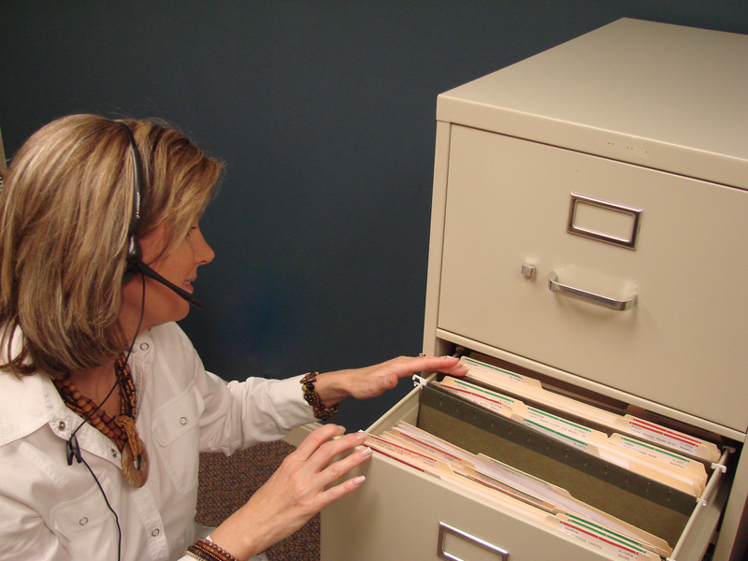
Administrative Exemption
Primary duty - office/non-manual work “directly” related to management or general business operations of employer or employer’s customers/clients
Primary duty includes exercise of discretion and independent judgment “with respect to matters of significance”
Examples: typically applies to claims adjusting, financial services, HR, auditing, tax, marketing, and quality control employees
Notes:
Most frequently litigated exemption
What is discretion and independent judgment?
Does the employee:
Evaluate options and select a particular one
Create or implement policies or operations
Conduct significant projects
Have authority to commit the employer
Have authority to vary from settled procedures
Provide expert advice to management
Handle problems as they arise, or recommend how problems should be handled

Slide 17

Learned Professional Exemption
Primary Duty - performance of work requiring an advanced type of knowledge
  Predominantly intellectual in character
  “Consistent” exercise of discretion and judgment in science or learning
  “Prolonged” course in specialized intellectual instruction (B.A. or B.S., or beyond)
  Examples: Accounting, law, education, medicine, engineering, theology, architecture, etc.
Notes:
Equivalent work experience in proposed regulations DELETED
“Occasionally,” a non-degree holder qualifies

Slide 18


Creative Professional Exemption
Primary Duty - the performance of work requiring invention, imagination, originality, or talent in a recognized field of artistic or creative endeavor
Music, writing, acting, graphic arts
Case by case basis determination depending on how much own creativity

Slide 19

Computer Professional Exemption
Employee paid $455 per week salary or $27.63 per hour or more
Employee’s Primary Duty:
  The application of systems analysis techniques and procedures, including consulting with users, to determine hardware, software, or system functional specifications
  The design of computer systems based on and related to user or system design specifications
  The creation or modification
  of computer programs related
  to machine operating systems

Slide 20

Outside Sales Exemption
Primary Duty - making sales or obtaining orders for services or for use of facilities, and
Employee customarily and regularly engages in work away from the employer’s place of business
No salary requirement or particular salary level
Regulations explicitly exclude from the exemption “Inside Sales”

Slide 21
Highly Compensated Employees
$100,000 or more –
  Exempt if they meet any one of the criteria of the executive, administrative, or professional duties
  Office or non-manual work
  Significantly higher than $65,000 in proposed regulations
  $100,000 = Salary, Commissions and Non-Discretionary Bonuses

Slide 22
Is This Employee Exempt?
Sushi chef at restaurant
Supervised by head (No.1) chef
Paid on salary basis (above $455/wk)
Not required to have a degree in culinary arts but is continually instructed at the restaurant in a classroom setting
Required to have 5-10 years of experience
Oversees the work of less experienced sushi chefs
Does not hire, fire, promote or discipline lower level chefs

Slide 23
What do you think?
Is this employee exempt?
Exempt under Executive Exemption
Exempt under Professional Exemption
Exempt under Administrative Exemption
Non-Exempt

Slide 24
Real Case
D. Non-Exempt
Not exempt under Executive exemption – no evidence that mid-level chef made suggestions or recommendations as to hiring, firing, promotion, etc. of lower level chefs
Not exempt under Learned Professional exemption – did not require academic degree
Solis v. Suroc, No. 1:12 CV 2107 (N.D. Ohio 2014)

Slide 25
Cost of Misclassification
  Jim is an assistant manager at Wellness Pharmacy
  Jim has no supervisory authority and does not manage others (he is not exempt)
  Jim has been treated as an exempt employee
  His pay over the last three years has been at a rate of $15 per hour
  Jim now claims he has worked 45 hours/week the last three years

Slide 26

It Will Cost You!
Cost of Misclassification:
Number of hours > 40 x 1.5 Regular Rate
x 2 years (not willful) or 3 years (willful))
x 2 (Liquidated Damages)
x Employees
+ Attorney Fees (Employer and Plaintiff)
+ Costs of Litigation + Costs of Employees Participating in Litigation
Notes:
NOTE: If employer paid a salary, and employees were already compensated for the time worked, then employer would only multiply the regular rate times .5

Slide 27
Unpaid Wages
Individual Action
    150 weeks (for the three years) x 5 hours per week =
    750 overtime hours
    750 overtime hours x $22.50 ($15 x 1.5) = $ 16,875 in unpaid wages
    Liquidated damages : $16,875 x 2 = $33,750
  vs.
Collective Action
    100 current and former assistant managers join the collective action
    100 x $16,875 = $1,687,500 in unpaid wages
    Liquidated damages: $1,687,500 x 2 = $3,375,000

Slide 28
Attorney’s Fees And Costs
Under the FLSA, prevailing plaintiffs are entitled to an award of their attorneys’ fees
Plus you have to add in your own fees in defense of the case

Slide 29
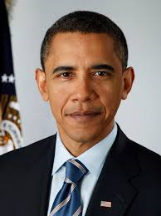
Revision to White Collar Exemptions in the Works!
March 2014 – President ordered DOL to revise the white collar exemptions to reflect the “modern economy”
DOL expected to release proposed changes in November 2014 but that has been delayed
Likely changes:
  Raise the minimum salary level (some speculate the amount may double to $46,800/year)
  Change the duties tests to add in a quantitative test (e.g., more than 50% of time spent on supervising employees)
  Raise the minimum salary level for the highly compensated worker exemption
Notes:
Republican Response: Washington D.C., March 2014: U.S. Senator Lamar Alexander (R-Tenn): The president’s directive “seems engineered to make it as unappealing as possible to be an employer creating jobs in this country.”
Discuss the Grace Case 637 F.3d 505 (4th Cir. 2011)
Secretary of Labor Tom Perez and Obama have said an employee can stock shelves 99 percent of the time and manage 1 percent of the time and be exempt. Something needs to change.

Slide 30
Senate Bill
Following President’s lead, Senate Democrats introduced “Restoring Overtime Pay for Working Americans Act” in 2014 to:
Raise minimum salary for white collar exemptions to $1,090 per week ($56,680 per year) – phased in
Raise highly compensated employee minimum to $125,000 per year
Restore 50% threshold for “primary” duties
Notes:
Salary minimums would be phased in over time and would be indexed to inflation
Bill died last year when Congressional session ended without passing -- but suggests where the DOL may go with the revisions

Slide 31
What Should You Do?
New rules could take effect in 12-18 months:
  Identify “white-collar” exempt employees whose salary is in the $455 - $1000 / week range
  Determine what percentage of time is spent on exempt duties (can you reallocate duties)
  Review and update job descriptions
  Identify cost of losing exemption (is it cheaper to lose the exemption or increase salary)

Slide 32
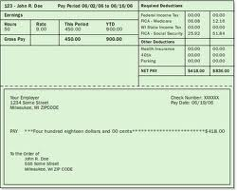
Exempt Employee Salary Deductions
Generally, exempt employees must be paid their full salary for all weeks in which they perform any work, regardless of quantity or quality
Beware of the “fake salary!”
Can lose the exemption for all employees in the same job and the same affected department!

Slide 33
Exempt Employee Pay Deductions
You can deduct for:
  Absence from work for one or more full days for personal reasons, other than sickness or disability;
  Absences due to sickness/disability of a full day if the deductions are made under a bona fide plan, policy or practice of providing replacement pay for these types of absences;
  No deductions, only offsets, for jury fees, witness fees, or military pay;

Slide 34
Exempt Employee Pay Deductions continued
  Deductions of any type may be imposed in good faith for violating safety rules of “major significance”;
  Unpaid disciplinary suspension of one or more full days imposed in good faith for violations of workplace conduct rules (e.g., sexual harassment, workplace violence);
  Proportional rate of full salary for time actually worked in the first and last weeks of employment; and
  Any unpaid leave taken pursuant to the Family and Medical Leave Act.

Slide 35

Safe Harbor for Pay Deductions
Safe harbor for inadvertent and isolated improper deductions if:
  Written policy concerning deductions
  Written notice of policy given to employees
  Policy contains complaint procedure
  Employer responds and rectifies errors
  Full reimbursement made

Slide 36
Comp Time
For private employers, all wages must be paid for the pay period at issue and “make-up time” cannot be extended outside the work week
For public employees, “compensatory time” can be accrued up to specific limits, must be reasonably available for use, and must be paid out on termination

Slide 37
Intern or Employee?
College students agree to provide unpaid services to a company
Students perform low-level tasks, such as answering phones, making deliveries, picking up paychecks for other employees, etc.
Company provides training on how to perform these tasks but not on overall business
Students receive academic credit
No expectation of receiving a job at conclusion of service

Slide 38
What do you think?
Are the students interns or employees?
Unpaid interns - they receive academic credit
Unpaid interns - they agreed they won’t be paid for their services
Employees – they performed work that other employees would have to do
I don’t know

Slide 39
Real Case
Similar to Fox Searchlight intern case
Employees - work did not primarily benefit interns, company did not provide training on the operational aspects of the business, and other employees would have had to perform these tasks
Workers cannot waive FLSA coverage
Case is on appeal so stay tuned
Glatt v. Fox Searchlight Pictures, Inc., No. 11 civ 6784 (S.D.N.Y. June 11, 2013)
Notes:
Unpaid Interns:
Six Rules to Follow:
The internship is similar to training that would be given in an educational environment
It is for the benefit of the intern
The intern doesn’t displace regular employees
Employer derives no immediate advantages
Intern is not necessarily entitled to a job at the conclusion of program
Both parties understand the intern isn’t entitled to wages

Slide 40
State and Local Wage & Hour Issues
Minimum wage – some are higher than federal
Overtime exemptions – defined differently than under FLSA
Meal and break periods
  Are meals and breaks required
  Paid or unpaid?
Wage payment laws
  How often must workers be paid
  When must final paycheck be made
  What must be included in itemized wage statement

Slide 41


Slide 42
Liability For FLSA Violations
“Any person acting directly or indirectly in the interest of the employer in relation to the employee” …
  Power to hire and fire
  Control over schedule of work or conditions of employment
  Maintenance of records
  Control over method or rate of payment
  Control over business enterprise (more than one business for common purpose)
Possible criminal penalties too

Slide 43
Take-Aways
DOL is cracking down on FLSA violations
Private FLSA lawsuits on the rise
Misclassifications and other FLSA violations are costly!
Perform regular audits to ensure compliance:
  Employee vs. independent contractors
  Exempt vs. non-exempt
  Pay deductions
  Interns
  Proper record-keeping

Slide 44
Questions?
A. Dean Bennett
Holland & Hart LLP
(208) 342-5000
ADBennett@hollandhart.com

